Slide 1
Audience engagement
Some ideas, suggestions, proposals

Slide 2
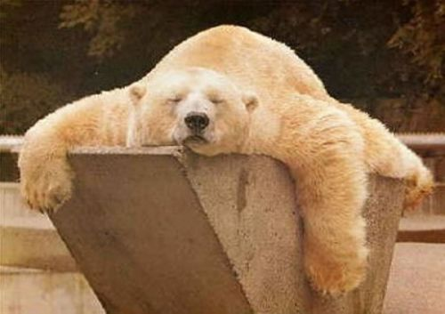
Be Active!
Active participation is about change and innovation
Why I don’t like the formula AUDIENCE DEVELOPMENT? It presumes that audience are passive and need to be developped, it implies a cultural deficit

Slide 3
9° of May 1921.Debut of «Six characters in search of an author» by LuigiPirandello
Audience booed the show shouting «Manicomio! Manicomio!» (mental hospital) – beyond the aesthetic tastes, I would define it as a form of spectators’ active participation

Slide 4
Social relevance of culture
every active citizenship activity is the consequence of a widespread disinterest
less engagement, more attempts to engage people
the possible utopia of the democratization of culture has not been fulfilled (with disappointing results, regardless of the political recipes adopted) and, in a context of reduced welfare, the economic sustainability of cultural activity is increasingly inseparable from social sustainability and innovation. (Alessandro Bollo)

Slide 5
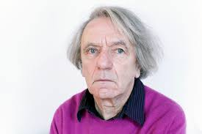
A POLITICAL ASPECT
It is not asking people to do what they want: it a political question
It is about intellectual emancipation: leave passive attitude and enter in an intellectual adventure
Jacques Ranciére «The Emancipated Spectator»: in my perspective, I prefere to speak about spectators emotionally emancipated

Slide 6
CREATIVITY IS NOT THE PRODUCT OF SINGLE INDIVIDUALS, BUT OF SOCIAL SYSTEMS (Mihaly Czikszentmihalyi, 2005)

Slide 7
CULTURE CAN ACT AS AN INTERMINABLE CIRCUIT OF INTER-LEGITIMATION (Pierre Bordieu, 1984)

Slide 8
3 different perspectives
Participatory Art Work
Audience Engagement
Active Spectatorship
a form of art that directly engages the audience in the creative process so that they become participants in the event
creating an interactive narrative with your attendees to create a desired outcome /
providing an outlet for audiences to interact with, be it through an empowered presenter or a physical stimulus /
an emotional involvement or commitment by an audience
each mechanism through which audiences take on the role of decision makers with regard to many of the aspects needed to carry out the programming of a theatre/ festival /season / exposition etc.

Slide 9
For what?
To enlarge the number of audience
To meet the needs of the potential audience
To engage new audience
To improve the competencies of existing the audience
Marketing (customer care) Education
Or it is a philosophy? An attitude???

Slide 10
Refractory
Potential
Occasional
Loyal

Slide 11
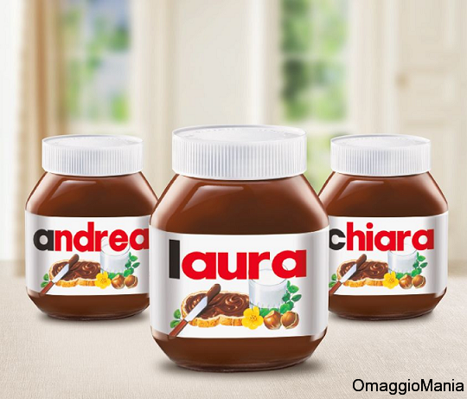
The progressive inclusion of consumers in the creation of value represent one of the most significant trends in the contemporary society (Adam Arvidsson, 2008)
Co-creation practices are an integral part of artistic experiences, as consumers engage in cognitive, emotional and imaginal practices to appropriate and make sense of a cultural product (Kay Caldwell, 2011)

Slide 12
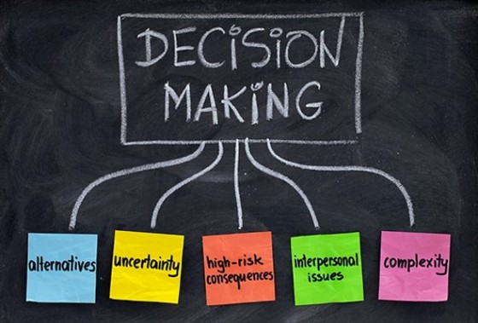
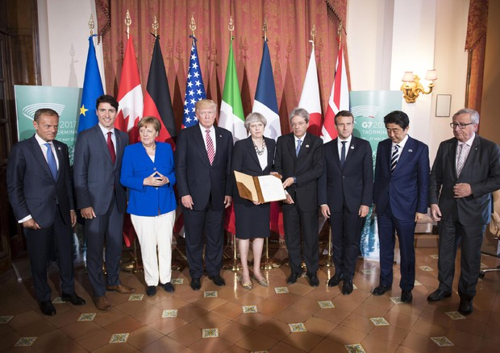
Cultural Democracy
To give people a voice at the table where cultural decision were taken
To give people a voice and an ownership in the cultural venues
If I’m an active spectator I need to know that my presence make a difference

Slide 13
Aims and strategies
Broadening the audience
Diversifying the audience
Improvement of the relationship
To reach (advertising, pricing, digital strategies / guerrilla marketing, different timings)
To engage (co-creation, contests / educational, mediation, experiential / ambassadors, membership, visionaries)

Slide 14
From the 4 P to the 4 E by Ben Walmsley
From To
Products Experiences
Promotion Engagement
Price Exchanges of Values
Place Environment
Future organizations will be artistically led, but audience-centric

Slide 15
Some problems
Every active spectatorship mechanism is strongly local and irrepaceable on a large scale
The issue of participation bring with itself this dilemma: we have to understand where we have to stop listening people and to start challenging
When you start a participatory program you have many chances to convoque elites
How to manage the legacy of these processes? How we can difend and implement the outputs?
It could be useful to create an internal system for testing the effectiveness of these processes?
EVENTUALLY: don’t transform the work with/for audience in a sort of religion!

