Slide 1
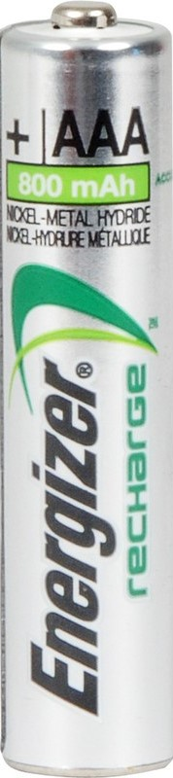
ART AND ACTIVISM
Igor Stokfiszewski
Krytyka Polityczna
www.krytykapolityczna.pl
www.politicalcritique.org

Slide 2
ART AND ACTIVISM
three suggestions how to increase the political effectiveness of artistic action
Igor Stokfiszewski
Krytyka Polityczna
www.krytykapolityczna.pl
www.politicalcritique.org

Slide 3
ART AND ACTIVISM
three suggestions how to increase the political effectiveness of artistic action
Igor Stokfiszewski
Krytyka Polityczna
www.krytykapolityczna.pl
www.politicalcritique.org
1. rethinking the issue: socio-political self-instrumentalization of art; reactivating the attitude of “the party-member artist”; rethinking the propaganda function of art.

Slide 4
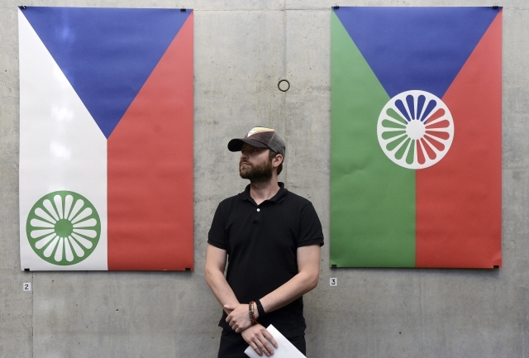
Self-instrumentalization of art
three suggestions how to increase the political effectiveness of artistic action
Igor Stokfiszewski
Krytyka Polityczna
www.krytykapolityczna.pl
www.politicalcritique.org
1. rethinking the issue: socio-political self-instrumentalization of art; reactivating the attitude of “the party-member artist”; rethinking the propaganda function of art.
Tomáš Rafa since 2009 has been implementing a series of video works under the joint title of New Nationalism.

Slide 5
Self-instrumentalization of art
three suggestions how to increase the political effectiveness of artistic action
Igor Stokfiszewski
Krytyka Polityczna
www.krytykapolityczna.pl
www.politicalcritique.org
1. rethinking the issue: socio-political self-instrumentalization of art; reactivating the attitude of “the party-member artist”; rethinking the propaganda function of art.
Tomáš Rafa since 2009 has been implementing a series of video works under the joint title of New Nationalism.
Rafa's works bring knowledge about the subsequent stages of the process of shaping nationalist tendencies in the region, and released through Internet are a source of information for representatives of left-wing social movements.

Slide 6
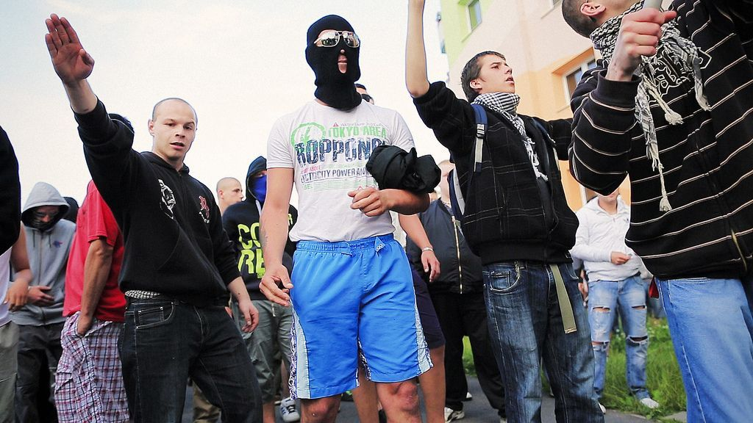
Self-instrumentalization of art
three suggestions how to increase the political effectiveness of artistic action
Igor Stokfiszewski
Krytyka Polityczna
www.krytykapolityczna.pl
www.politicalcritique.org
1. rethinking the issue: socio-political self-instrumentalization of art; reactivating the attitude of “the party-member artist”; rethinking the propaganda function of art.
Tomáš Rafa since 2009 has been implementing a series of video works under the joint title of New Nationalism.
Rafa's works bring knowledge about the subsequent stages of the process of shaping nationalist tendencies in the region, and released through Internet are a source of information for representatives of left-wing social movements.
Rafa’s most-watched films have from five hundred thousand to over one and a half million views.

Slide 7
Self-instrumentalization of art
three suggestions how to increase the political effectiveness of artistic action
Tomáš Rafa self-instrumentalises his own artistic practice, putting it in the service of left-wing social movements.
Igor Stokfiszewski
Krytyka Polityczna
www.krytykapolityczna.pl
www.politicalcritique.org
1. rethinking the issue: socio-political self-instrumentalization of art; reactivating the attitude of “the party-member artist”; rethinking the propaganda function of art.
Tomáš Rafa since 2009 has been implementing a series of video works under the joint title of New Nationalism.
Rafa's works bring knowledge about the subsequent stages of the process of shaping nationalist tendencies in the region, and released through Internet are a source of information for representatives of left-wing social movements.
Rafa’s most-watched films have from five hundred thousand to over one and a half million views.

Slide 8
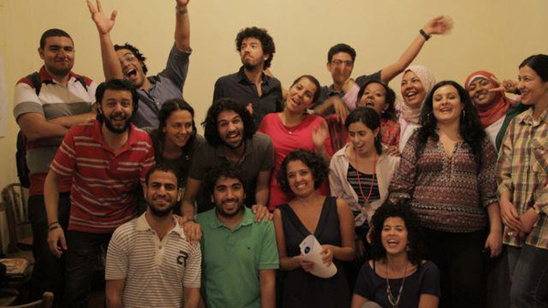
Self-instrumentalization of art
three suggestions how to increase the political effectiveness of artistic action
Tomáš Rafa self-instrumentalises his own artistic practice, putting it in the service of left-wing social movements.
Igor Stokfiszewski
Krytyka Polityczna
www.krytykapolityczna.pl
www.politicalcritique.org
1. rethinking the issue: socio-political self-instrumentalization of art; reactivating the attitude of “the party-member artist”; rethinking the propaganda function of art.
Tomáš Rafa since 2009 has been implementing a series of video works under the joint title of New Nationalism.
Rafa's works bring knowledge about the subsequent stages of the process of shaping nationalist tendencies in the region, and released through Internet are a source of information for representatives of left-wing social movements.
Mosireen collective – the voice of Egiptian revolution
Rafa’s most-watched films have from five hundred thousand to over one and a half million views.

Slide 9
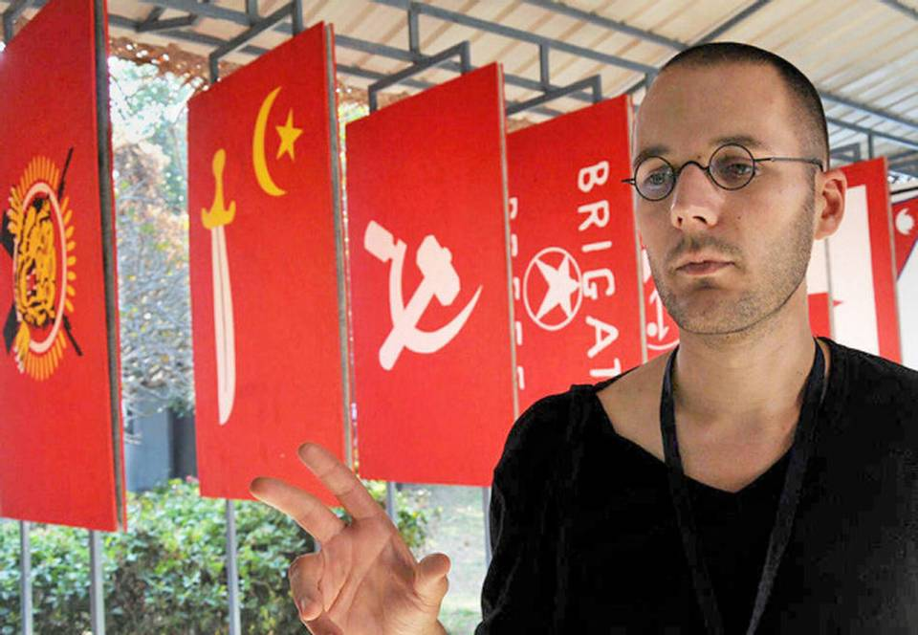
Self-instrumentalization of art
Political
three suggestions how to increase the political effectiveness of artistic action
1. rethinking the issue: socio-political self-instrumentalization of art; reactivating the attitude of “the party-member artist”; rethinking the propaganda function of art.
Jonas Staal

Slide 10
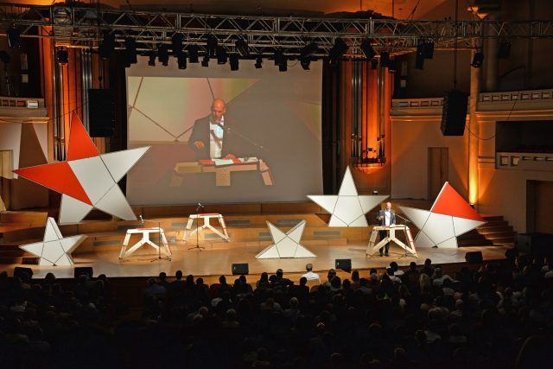
Self-instrumentalization of art
Political
three suggestions how to increase the political effectiveness of artistic action
1. rethinking the issue: socio-political self-instrumentalization of art; reactivating the attitude of “the party-member artist”; rethinking the propaganda function of art.
Jonas Staal

Slide 11
Self-instrumentalization of art
Political
three suggestions how to increase the political effectiveness of artistic action
1. rethinking the issue: socio-political self-instrumentalization of art; reactivating the attitude of “the party-member artist”; rethinking the propaganda function of art.
“I’m an artist, I’m a member of DiEM25 (…). Here gathered at Bozar we represent an alternative but only if every single one of us puts our hearts and our passion and our craft and our imagination in this movement, only if we become members and representatives and activists we can take back our imagination (…). (…) We have the plans and we have people to do it. (…) I’m here to say that now you have the artists too.”
Jonas Staal

Slide 12
Self-instrumentalization of art
Political
three suggestions how to increase the political effectiveness of artistic action
1. rethinking the issue: socio-political self-instrumentalization of art; reactivating the attitude of “the party-member artist”; rethinking the propaganda function of art.
“I’m an artist, I’m a member of DiEM25 (…). Here gathered at Bozar we represent an alternative but only if every single one of us puts our hearts and our passion and our craft and our imagination in this movement, only if we become members and representatives and activists we can take back our imagination (…). (…) We have the plans and we have people to do it. (…) I’m here to say that now you have the artists too.”
Jonas Staal
party-member artist

Slide 13
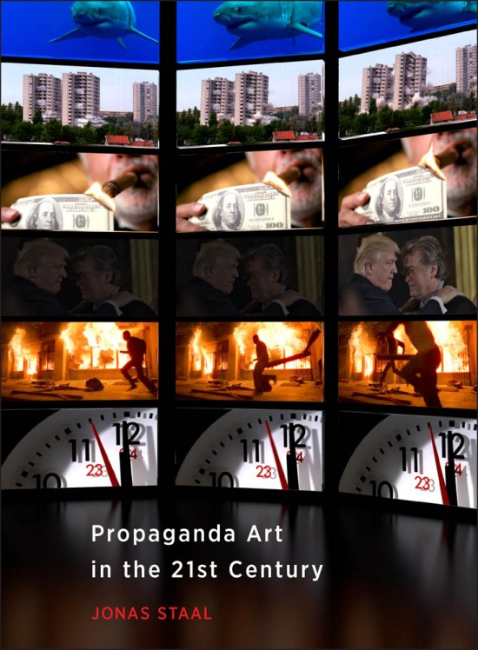
Self-instrumentalization of art
Political
three suggestions how to increase the political effectiveness of artistic action
1. rethinking the issue: socio-political self-instrumentalization of art; reactivating the attitude of “the party-member artist”; rethinking the propaganda function of art.
“I’m an artist, I’m a member of DiEM25 (…). Here gathered at Bozar we represent an alternative but only if every single one of us puts our hearts and our passion and our craft and our imagination in this movement, only if we become members and representatives and activists we can take back our imagination (…). (…) We have the plans and we have people to do it. (…) I’m here to say that now you have the artists too.”
Jonas Staal
party-member artist

Slide 14
Self-instrumentalization of art
Political
three suggestions how to increase the political effectiveness of artistic action
1. rethinking the issue: socio-political self-instrumentalization of art; reactivating the attitude of “the party-member artist”; rethinking the propaganda function of art.
"My name is Jonas Staal and I am a propaganda artist"
“I’m an artist, I’m a member of DiEM25 (…). Here gathered at Bozar we represent an alternative but only if every single one of us puts our hearts and our passion and our craft and our imagination in this movement, only if we become members and representatives and activists we can take back our imagination (…). (…) We have the plans and we have people to do it. (…) I’m here to say that now you have the artists too.”
Jonas Staal
party-member artist

Slide 15
three suggestions how to increase the political effectiveness of artistic action
1. rethinking the issue: socio-political self-instrumentalization of art; reactivating the attitude of “the party-member artist”; rethinking the propaganda function of art.
2. artivism – the art of creating platforms for political expression intended for those who have no voice

Slide 16
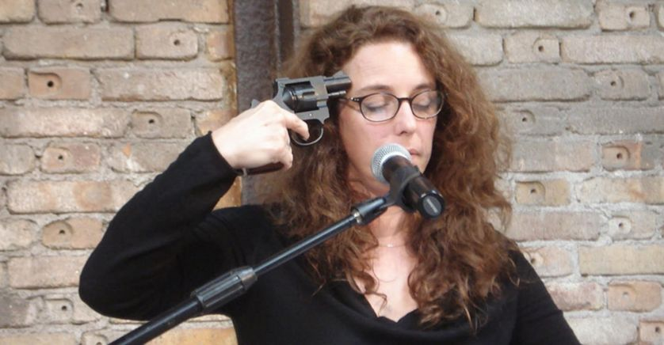
Artivism
three suggestions how to increase the political effectiveness of artistic action
1. rethinking the issue: socio-political self-instrumentalization of art; reactivating the attitude of “the party-member artist”; rethinking the propaganda function of art.
2. artivism – the art of creating platforms for political expression intended for those who have no voice
Tania Bruguera – founder of the Hannah Arendt International Institute of Artivism

Slide 17
Artivism
"giving space of self-expression to people who want to send a message to those in power"
three suggestions how to increase the political effectiveness of artistic action
1. rethinking the issue: socio-political self-instrumentalization of art; reactivating the attitude of “the party-member artist”; rethinking the propaganda function of art.
2. artivism – the art of creating platforms for political expression intended for those who have no voice
Tania Bruguera – founder of the Hannah Arendt International Institute of Artivism

Slide 18
Artivism
"giving space of self-expression to people who want to send a message to those in power"
three suggestions how to increase the political effectiveness of artistic action
1. rethinking the issue: socio-political self-instrumentalization of art; reactivating the attitude of “the party-member artist”; rethinking the propaganda function of art.
2. artivism – the art of creating platforms for political expression intended for those who have no voice
Tania Bruguera – founder of the Hannah Arendt International Institute of Artivism
art undergoes self-instrumentalization for the benefit of communities and disadvantaged groups;
the artist takes the role of facilitator of the emancipatory political process

Slide 19
Artivism
"giving space of self-expression to people who want to send a message to those in power"
three suggestions how to increase the political effectiveness of artistic action
renewal of community art
1. rethinking the issue: socio-political self-instrumentalization of art; reactivating the attitude of “the party-member artist”; rethinking the propaganda function of art.
2. artivism – the art of creating platforms for political expression intended for those who have no voice
Tania Bruguera – founder of the Hannah Arendt International Institute of Artivism
art undergoes self-instrumentalization for the benefit of communities and disadvantaged groups;
the artist takes the role of facilitator of the emancipatory political process

Slide 20
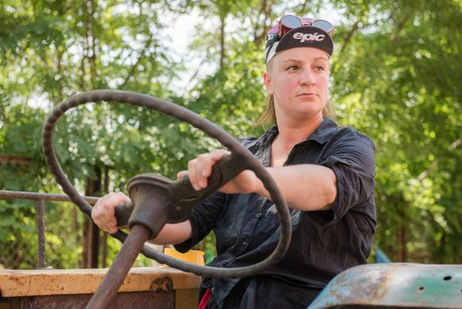
Artivism
"giving space of self-expression to people who want to send a message to those in power"
three suggestions how to increase the political effectiveness of artistic action
renewal of community art
1. rethinking the issue: socio-political self-instrumentalization of art; reactivating the attitude of “the party-member artist”; rethinking the propaganda function of art.
2. artivism – the art of creating platforms for political expression intended for those who have no voice
Tania Bruguera – founder of the Hannah Arendt International Institute of Artivism
Jaśmina Wójcik
art undergoes self-instrumentalization for the benefit of communities and disadvantaged groups;
the artist takes the role of facilitator of the emancipatory political process

Slide 21
Artivism
"giving space of self-expression to people who want to send a message to those in power"
three suggestions how to increase the political effectiveness of artistic action
renewal of community art
1. rethinking the issue: socio-political self-instrumentalization of art; reactivating the attitude of “the party-member artist”; rethinking the propaganda function of art.
2. artivism – the art of creating platforms for political expression intended for those who have no voice
Tania Bruguera – founder of the Hannah Arendt International Institute of Artivism
Jaśmina Wójcik
art undergoes self-instrumentalization for the benefit of communities and disadvantaged groups;
the artist takes the role of facilitator of the emancipatory political process
giving community a space for self-expression;
providing them tools for direct political action

Slide 22
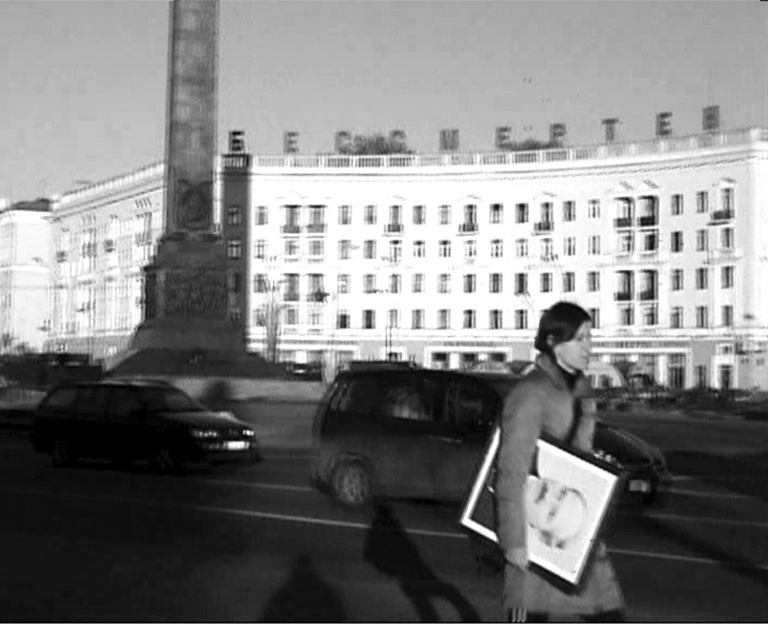
Artivism
"giving space of self-expression to people who want to send a message to those in power"
three suggestions how to increase the political effectiveness of artistic action
renewal of community art
1. rethinking the issue: socio-political self-instrumentalization of art; reactivating the attitude of “the party-member artist”; rethinking the propaganda function of art.
Marina Naprushkina
2. artivism – the art of creating platforms for political expression intended for those who have no voice
Tania Bruguera – founder of the Hannah Arendt International Institute of Artivism
Jaśmina Wójcik
art undergoes self-instrumentalization for the benefit of communities and disadvantaged groups;
the artist takes the role of facilitator of the emancipatory political process
giving community a space for self-expression;
providing them tools for direct political action

Slide 23
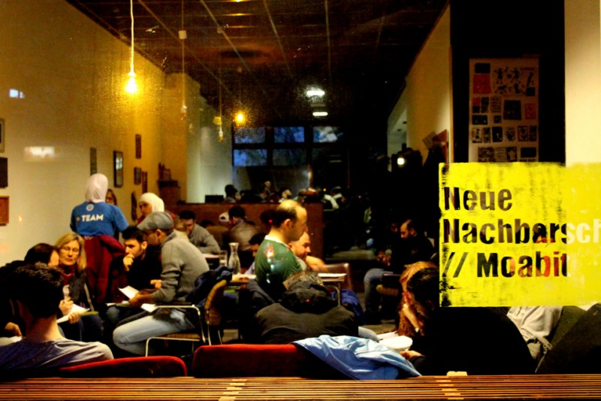
Artivism
"giving space of self-expression to people who want to send a message to those in power"
three suggestions how to increase the political effectiveness of artistic action
renewal of community art
1. rethinking the issue: socio-political self-instrumentalization of art; reactivating the attitude of “the party-member artist”; rethinking the propaganda function of art.
Marina Naprushkina
autonomous New Neighborhood centre in Berlin serves refugees as a platform for their social and political self-organization
2. artivism – the art of creating platforms for political expression intended for those who have no voice
Tania Bruguera – founder of the Hannah Arendt International Institute of Artivism
Jaśmina Wójcik
art undergoes self-instrumentalization for the benefit of communities and disadvantaged groups;
the artist takes the role of facilitator of the emancipatory political process
giving community a space for self-expression;
providing them tools for direct political action

Slide 24
Artivism
"giving space of self-expression to people who want to send a message to those in power"
three suggestions how to increase the political effectiveness of artistic action
renewal of community art
1. rethinking the issue: socio-political self-instrumentalization of art; reactivating the attitude of “the party-member artist”; rethinking the propaganda function of art.
Marina Naprushkina
art using participatory tools
autonomous New Neighborhood centre in Berlin serves refugees as a platform for their social and political self-organization
2. artivism – the art of creating platforms for political expression intended for those who have no voice
Tania Bruguera – founder of the Hannah Arendt International Institute of Artivism
Jaśmina Wójcik
art undergoes self-instrumentalization for the benefit of communities and disadvantaged groups;
the artist takes the role of facilitator of the emancipatory political process
giving community a space for self-expression;
providing them tools for direct political action

Slide 25
Artivism
"giving space of self-expression to people who want to send a message to those in power"
three suggestions how to increase the political effectiveness of artistic action
participation as a new paradigm of art
renewal of community art
1. rethinking the issue: socio-political self-instrumentalization of art; reactivating the attitude of “the party-member artist”; rethinking the propaganda function of art.
Marina Naprushkina
art using participatory tools
autonomous New Neighborhood centre in Berlin serves refugees as a platform for their social and political self-organization
2. artivism – the art of creating platforms for political expression intended for those who have no voice
Tania Bruguera – founder of the Hannah Arendt International Institute of Artivism
Jaśmina Wójcik
art undergoes self-instrumentalization for the benefit of communities and disadvantaged groups;
the artist takes the role of facilitator of the emancipatory political process
giving community a space for self-expression;
providing them tools for direct political action

Slide 26
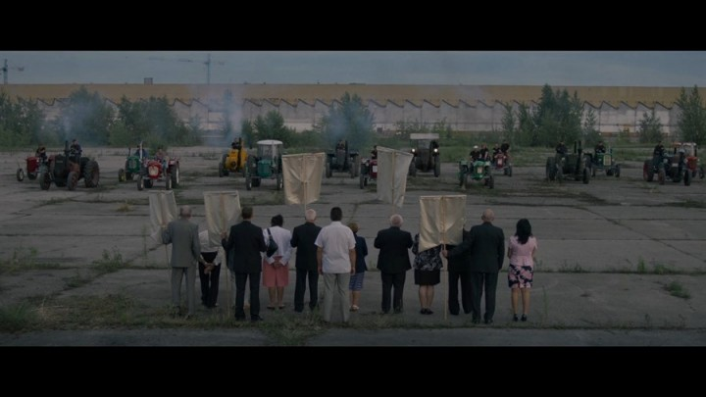
Artivism
"giving space of self-expression to people who want to send a message to those in power"
three suggestions how to increase the political effectiveness of artistic action
participation as a new paradigm of art
renewal of community art
1. rethinking the issue: socio-political self-instrumentalization of art; reactivating the attitude of “the party-member artist”; rethinking the propaganda function of art.
Marina Naprushkina
art using participatory tools
autonomous New Neighborhood centre in Berlin which serves refugees as a platform for their social and political self-organization
2. artivism – the art of creating platforms for political expression intended for those who have no voice
Tania Bruguera – founder of the Hannah Arendt International Institute of Artivism
Jaśmina Wójcik
art undergoes self-instrumentalization for the benefit of communities and disadvantaged groups;
the artist takes the role of facilitator of the emancipatory political process
giving community a space for self-expression;
providing them tools for direct political action
Symphony of the Ursus Factory

Slide 27
Artivism
"giving space of self-expression to people who want to send a message to those in power"
three suggestions how to increase the political effectiveness of artistic action
participation as a new paradigm of art
renewal of community art
1. rethinking the issue: socio-political self-instrumentalization of art; reactivating the attitude of “the party-member artist”; rethinking the propaganda function of art.
Marina Naprushkina
art using participatory tools
autonomous New Neighborhood centre in Berlin which serves refugees as a platform for their social and political self-organization
2. artivism – the art of creating platforms for political expression intended for those who have no voice
Tania Bruguera – founder of the Hannah Arendt International Institute of Artivism
Jaśmina Wójcik
art undergoes self-instrumentalization for the benefit of communities and disadvantaged groups;
the artist takes the role of facilitator of the emancipatory political process
giving community a space for self-expression;
providing them tools for direct political action
Symphony of the Ursus Factory
participatory action using film tools
not a film using participatory tools

Slide 28
three suggestions how to increase the political effectiveness of artistic action
1. rethinking the issue: socio-political self-instrumentalization of art; reactivating the attitude of “the party-member artist”; rethinking the propaganda function of art.
2. artivism – the art of creating platforms for political expression intended for those who have no voice
3. activism within the field of art (workers' movement in culture, the movement for the democratization of cultural institutions and cultural organizations, the movement for the right to culture)

Slide 29
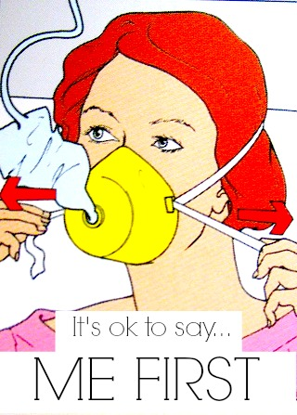
Activism within the field of art
three suggestions how to increase the political effectiveness of artistic action
1. rethinking the issue: socio-political self-instrumentalization of art; reactivating the attitude of “the party-member artist”; rethinking the propaganda function of art.
2. artivism – the art of creating platforms for political expression intended for those who have no voice
3. activism within the field of art (workers' movement in culture, the movement for the democratization of cultural institutions and cultural organizations, the movement for the right to culture)

Slide 30
Activism within the field of art
three suggestions how to increase the political effectiveness of artistic action
1. rethinking the issue: socio-political self-instrumentalization of art; reactivating the attitude of “the party-member artist”; rethinking the propaganda function of art.
2. artivism – the art of creating platforms for political expression intended for those who have no voice
democracy
3. activism within the field of art (workers' movement in culture, the movement for the democratization of cultural institutions and cultural organizations, the movement for the right to culture)

Slide 31
Activism within the field of art
three suggestions how to increase the political effectiveness of artistic action
1. rethinking the issue: socio-political self-instrumentalization of art; reactivating the attitude of “the party-member artist”; rethinking the propaganda function of art.
2. artivism – the art of creating platforms for political expression intended for those who have no voice
equality
democracy
3. activism within the field of art (workers' movement in culture, the movement for the democratization of cultural institutions and cultural organizations, the movement for the right to culture)

Slide 32
Activism within the field of art
three suggestions how to increase the political effectiveness of artistic action
1. rethinking the issue: socio-political self-instrumentalization of art; reactivating the attitude of “the party-member artist”; rethinking the propaganda function of art.
2. artivism – the art of creating platforms for political expression intended for those who have no voice
equality
democracy
freedom
3. activism within the field of art (workers' movement in culture, the movement for the democratization of cultural institutions and cultural organizations, the movement for the right to culture)

Slide 33
Activism within the field of art
three suggestions how to increase the political effectiveness of artistic action
1. rethinking the issue: socio-political self-instrumentalization of art; reactivating the attitude of “the party-member artist”; rethinking the propaganda function of art.
2. artivism – the art of creating platforms for political expression intended for those who have no voice
equality
democracy
IN
freedom
3. activism within the field of art (workers' movement in culture, the movement for the democratization of cultural institutions and cultural organizations, the movement for the right to culture)

Slide 34
Activism within the field of art
three suggestions how to increase the political effectiveness of artistic action
1. rethinking the issue: socio-political self-instrumentalization of art; reactivating the attitude of “the party-member artist”; rethinking the propaganda function of art.
2. artivism – the art of creating platforms for political expression intended for those who have no voice
equality
democracy
IN
freedom
3. activism within the field of art (workers' movement in culture, the movement for the democratization of cultural institutions and cultural organizations, the movement for the right to culture)
CULTURE

Slide 35
Activism within the field of art
three suggestions how to increase the political effectiveness of artistic action
New institutional critique
1. rethinking the issue: socio-political self-instrumentalization of art; reactivating the attitude of “the party-member artist”; rethinking the propaganda function of art.
2. artivism – the art of creating platforms for political expression intended for those who have no voice
equality
democracy
IN
freedom
3. activism within the field of art (workers' movement in culture, the movement for the democratization of cultural institutions and cultural organizations, the movement for the right to culture)
CULTURE

Slide 36
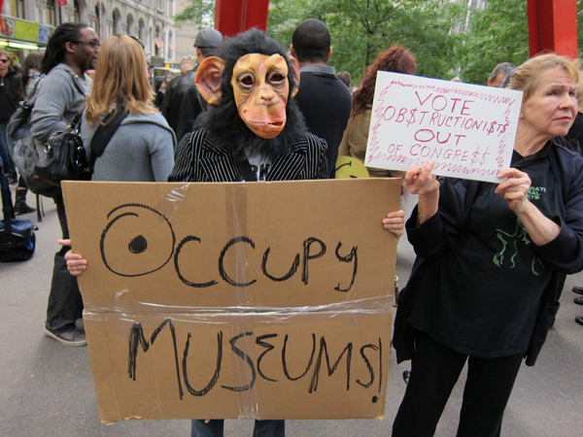
Activism within the field of art
three suggestions how to increase the political effectiveness of artistic action
New institutional critique
1. rethinking the issue: socio-political self-instrumentalization of art; reactivating the attitude of “the party-member artist”; rethinking the propaganda function of art.
2. artivism – the art of creating platforms for political expression intended for those who have no voice
equality
democracy
IN
freedom
3. activism within the field of art (workers' movement in culture, the movement for the democratization of cultural institutions and cultural organizations, the movement for the right to culture)
CULTURE

Slide 37
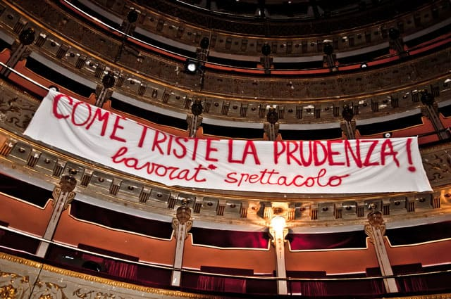
Activism within the field of art
three suggestions how to increase the political effectiveness of artistic action
New institutional critique
1. rethinking the issue: socio-political self-instrumentalization of art; reactivating the attitude of “the party-member artist”; rethinking the propaganda function of art.
2. artivism – the art of creating platforms for political expression intended for those who have no voice
equality
democracy
IN
freedom
3. activism within the field of art (workers' movement in culture, the movement for the democratization of cultural institutions and cultural organizations, the movement for the right to culture)
CULTURE

Slide 38
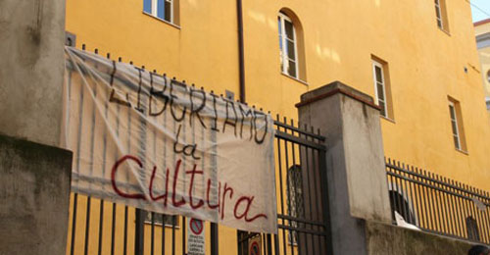
Activism within the field of art
three suggestions how to increase the political effectiveness of artistic action
New institutional critique
1. rethinking the issue: socio-political self-instrumentalization of art; reactivating the attitude of “the party-member artist”; rethinking the propaganda function of art.
2. artivism – the art of creating platforms for political expression intended for those who have no voice
equality
democracy
IN
freedom
3. activism within the field of art (workers' movement in culture, the movement for the democratization of cultural institutions and cultural organizations, the movement for the right to culture)
CULTURE

Slide 39
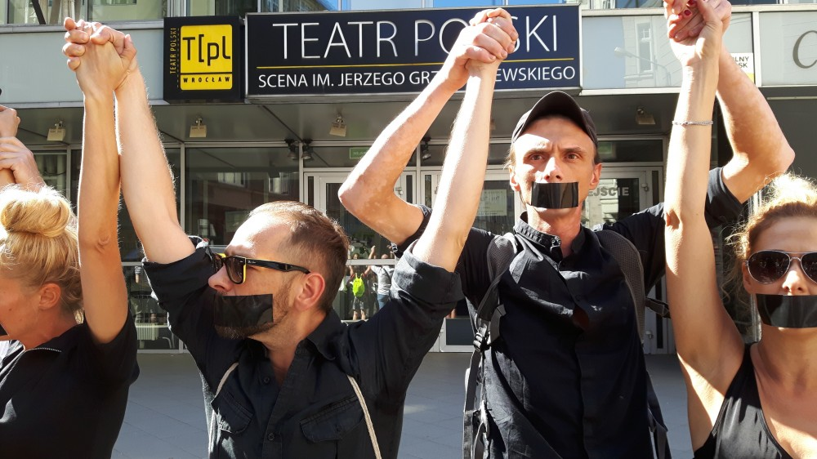
Activism within the field of art
three suggestions how to increase the political effectiveness of artistic action
New institutional critique
1. rethinking the issue: socio-political self-instrumentalization of art; reactivating the attitude of “the party-member artist”; rethinking the propaganda function of art.
2. artivism – the art of creating platforms for political expression intended for those who have no voice
equality
democracy
IN
freedom
3. activism within the field of art (workers' movement in culture, the movement for the democratization of cultural institutions and cultural organizations, the movement for the right to culture)
CULTURE

Slide 40
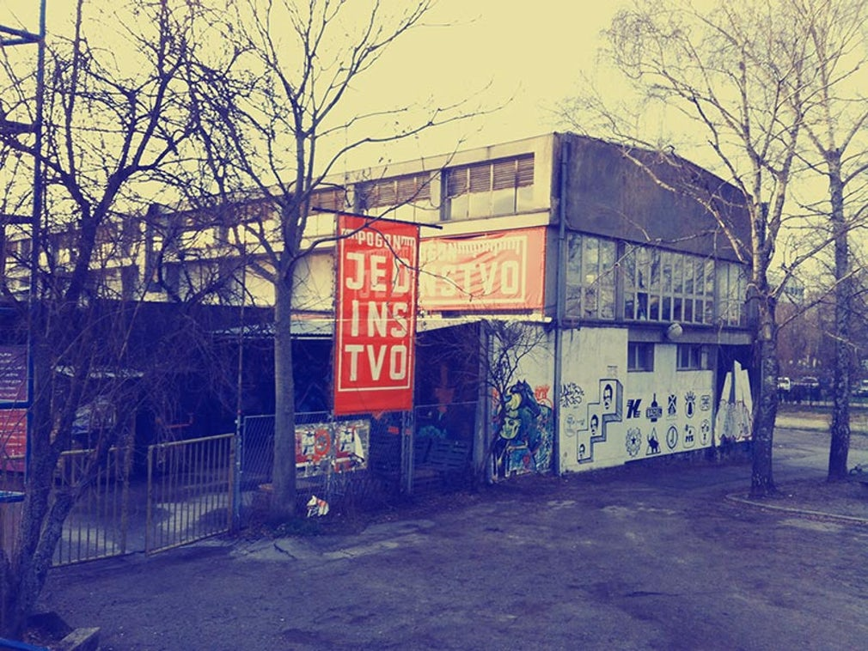
Activism within the field of art
three suggestions how to increase the political effectiveness of artistic action
New institutional critique
1. rethinking the issue: socio-political self-instrumentalization of art; reactivating the attitude of “the party-member artist”; rethinking the propaganda function of art.
2. artivism – the art of creating platforms for political expression intended for those who have no voice
equality
democracy
IN
freedom
3. activism within the field of art (workers' movement in culture, the movement for the democratization of cultural institutions and cultural organizations, the movement for the right to culture)
CULTURE

Slide 41
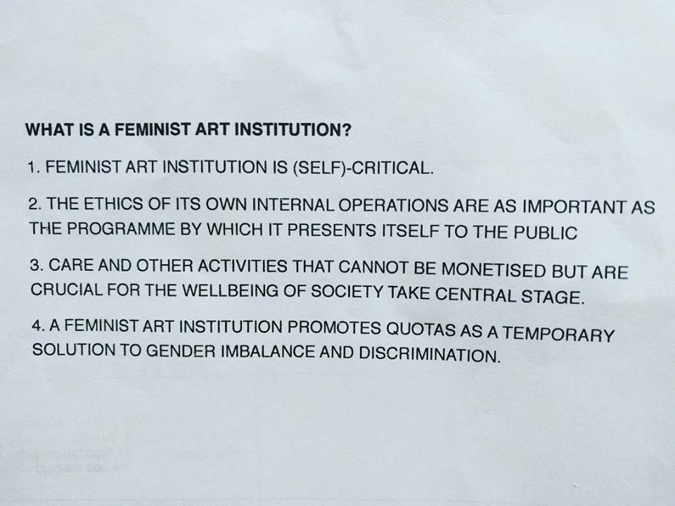
Activism within the field of art
three suggestions how to increase the political effectiveness of artistic action
New institutional critique
1. rethinking the issue: socio-political self-instrumentalization of art; reactivating the attitude of “the party-member artist”; rethinking the propaganda function of art.
2. artivism – the art of creating platforms for political expression intended for those who have no voice
equality
democracy
IN
freedom
3. activism within the field of art (workers' movement in culture, the movement for the democratization of cultural institutions and cultural organizations, the movement for the right to culture)
CULTURE

Slide 42
Activism within the field of art
three suggestions how to increase the political effectiveness of artistic action
fight for higher wages in the field of arts and culture;
greater transparency of the machinery of art;
raising the level of participation of artists, culture-makers and audiences in decision-making processes regarding culture;
taking control by artists, culture-makers and audiences over cultural production means
New institutional critique
1. rethinking the issue: socio-political self-instrumentalization of art; reactivating the attitude of “the party-member artist”; rethinking the propaganda function of art.
2. artivism – the art of creating platforms for political expression intended for those who have no voice
equality
democracy
IN
freedom
3. activism within the field of art (workers' movement in culture, the movement for the democratization of cultural institutions and cultural organizations, the movement for the right to culture)
CULTURE

Slide 43
three suggestions how to increase the political effectiveness of artistic action
Self-instrumentalization of art
Political self-instrumentalization
Propaganda
The party-member artist
Artivism
1. rethinking the issue: socio-political self-instrumentalization of art; reactivating the attitude of “the party-member artist”; rethinking the propaganda function of art.
Participation as a new paradigm
Activist-institutional critique
2. artivism – the art of creating platforms for political expression intended for those who have no voice
3. activism within the field of art (workers' movement in culture, the movement for the democratization of cultural institutions and cultural organizations, the movement for the right to culture)

Slide 44
three suggestions how to increase the political effectiveness of artistic action
Self-instrumentalization of art
Political self-instrumentalization
Propaganda
The party-member artist
Artivism
1. rethinking the issue: socio-political self-instrumentalization of art; reactivating the attitude of “the party-member artist”; rethinking the propaganda function of art.
Participation as a new paradigm
Activist-institutional critique
2. artivism – the art of creating platforms for political expression intended for those who have no voice
3. activism within the field of art (workers' movement in culture, the movement for the democratization of cultural institutions and cultural organizations, the movement for the right to culture)

Slide 45
three suggestions how to increase the political effectiveness of artistic action
Self-instrumentalization of art
Political self-instrumentalization
Propaganda
The party-member artist
Artivism
1. rethinking the issue: socio-political self-instrumentalization of art; reactivating the attitude of “the party-member artist”; rethinking the propaganda function of art.
Participation as a new paradigm
Activist-institutional critique
2. artivism – the art of creating platforms for political expression intended for those who have no voice
disappearance of the man-artist as a figure of an individual demiurge
3. activism within the field of art (workers' movement in culture, the movement for the democratization of cultural institutions and cultural organizations, the movement for the right to culture)

Slide 46
three suggestions how to increase the political effectiveness of artistic action
Self-instrumentalization of art
Political self-instrumentalization
Propaganda
The party-member artist
Artivism
1. rethinking the issue: socio-political self-instrumentalization of art; reactivating the attitude of “the party-member artist”; rethinking the propaganda function of art.
Participation as a new paradigm
Activist-institutional critique
emergence of the woman-artist as a figure of the collective facilitator of political emancipation processes that take place within communities, institutions and societies, using the tools of feminized culture
2. artivism – the art of creating platforms for political expression intended for those who have no voice
disappearance of the man-artist as a figure of an individual demiurge
3. activism within the field of art (workers' movement in culture, the movement for the democratization of cultural institutions and cultural organizations, the movement for the right to culture)

Slide 47
FIGHT AGAINST RACISM

Slide 48
FIGHT AGAINST RACISM
IMAGINE
BLACK
EUROPE

