Slide 1
Should we focus on seeking new audiences or should we engage more deeply with the existing ones? Are we there to mirror or create the audience? Can we talk about who is in the room and not only about who is not? Whom do we want to reach and why do we address audience to start with? Are we aware of what motivates our work with the audiences? Are we transparent about our relations with them? Do we include the right people in this relation?
WHO’S IN THE ROOM?
?

Slide 2
Objective of Session: to create a space and process through which the people in THIS room can bring their individual knowledge, practice, research and views to a conversation which seeks to answer the questions above, and in particular: How do we know who is in the room – who our audiences are? Do we need to know why they’re there? – and Why they’re not? If so, how do we find that out? Who do we want to bring to the room who’s not currently there and how might we do that?
WHO’S IN THE ROOM?

Slide 3
The Northern Social Circuit – Red Ladder Theatre
radical theatre company with 50 years of history
one of Britain’s leading small/medium scale national touring companies
producing new theatre, contributing to social change and global justice
theatre about and around human struggle
seeks to redefine and reclaim notions of popular, political and radical in a theatre context

Slide 4
The Northern Social Circuit – Red Ladder Theatre
Overall aims of the project
Provide high quality theatre in areas of low engagement
Connect non-attenders with theatre
Breathe new life into the social spaces in their communities
Up-skill and enthuse Community Programmers to select theatre to present in their clubs
Create a new circuit of non-theatre spaces which are confident to book and sell small-scale touring theatre in their venue.

Slide 5
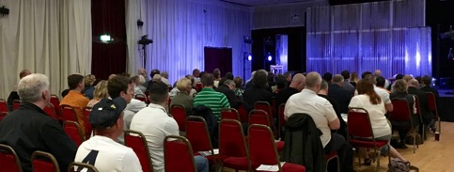
The Northern Social Circuit – Red Ladder Theatre
Arts Council-England funded – 3 year ‘Strategic Touring’ project
working with ‘Hub’ venues – local theatres in major towns wanting to attract wider audiences
create a Yorkshire network of small, non-traditional venues to host small-scale touring theatre
social clubs, community centres, sports clubs and pubs in areas of low income and high deprivation - at the heart of their community’s social life.
social spaces typically frequented by people who have low engagement in the arts, but attend their clubs with regularity
high quality and issue-based, connecting with people by reflecting working class lives
tapping into their passions (eg sport) and raising topics with broad human interest (eg mental illness).
Red Ladder identifies and works with a lead member of staff for the community who acts as a Community Programmer to book the entertainment for their venue.

Slide 6
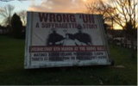
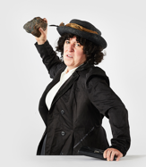
The Northern Social Circuit – Red Ladder Theatre
Typical northern working class communities and venues
Most were either first-time theatre attenders or attended ‘rarely’
a different audience profile for Northern Social Circuit than the audience profile of the ‘Hub’ venues
42% of audiences are from low engaged audience spectrum audiences
The vast majority of audiences are located within the immediate vicinity of the host venues
programming represents risk for programmers – something different in the club
96% gave the show they saw a 4 or 5 star rating
as a result of seeing a Northern Social Circuit show, 86% of respondents said they were ‘more likely’ or ‘much more likely’ to see another show

Slide 7
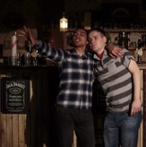
The Northern Social Circuit – Red Ladder Theatre
“Whoever did the writing, it was unique. I did not know what to expect. You certainly gave some good entertainment & things to think about. Thank you.”
“Loved it, great performances, really liked the stage production too, the video etc, cleverly done”
“Brilliant content, brilliant performances, powerful and moving, honest”
“Great to have affordable theatre which is so good”
“Brilliant, never seen anything like this before :)”
“Didn't know what to expect. Liked the close proximity of the actors, felt part of it. Really enjoyed it.”

Slide 8
The TOGETHER Project – Unimited Theatre
company formed 22 years ago
writers, performers, producers making and touring contemporary theatre
touring to theatres, festivals, museums, public spaces
specialise in working with scientists and researchers to make work around leading edge developments in science and technology
long term collaboration with Rash Dash theatre, making political, feminist work
dedicated strand of work for families, children and young people

Slide 9
The TOGETHER Project – Unimited Theatre
How can touring companies and venues develop more effective practice in their collaborative approaches to audience engagement and development?
Play Dough – a show for children about money and the financial crash (Unlimited Theatre)
Am I Dead Yet? – a show for adult audiences about death and dying (Unlimited Theatre)
Two Man Show – a show for adult audiences about gender, sex and patriarchy (Rash Dash)
Each show toured to 5 partner venues in the North of England

Slide 10
The TOGETHER Project – Unimited Theatre
engaging audiences beyond the usual theatre attenders at each venue
organising engagement activities on the themes of the show, eg ‘Death Cafes’, workshops
social interaction with local groups – informal drinks and chats
working with a Local Engagement Practitioner at each venue to develop conversations
looking at other barriers, eg marketing copy, transport, costs

Slide 11
The TOGETHER Project – Unimited Theatre
WHAT WAS LEARNED
best to tap into pre-existing groups, eg womens’ groups, bereavement support groups
be realistic about the first-time audiences you will attract – target groups already engaged in the subject matter
collaboration with venue is key - on all aspects of audience engagement. Venues need to be committed to diversifying audience
engagement of LEP’s was also crucial – don’t expect actors to do all the engagement
listening to LEP’s – they know the area and the audience

