Slide 1
Diversity and inclusion at
the Australia Council for the Arts
Jeremy Smith and Sophie Travers

Slide 2
Australia Council for the Arts
Australian Government’s principal funding and advisory body for the arts
Functions include: to support art that reflects the diversity of Australia
Notes:
The Australia Council first began in 1967 (we just turned 50)
We are constituted by an Act of the Federal Parliament (Australia Council Act) as the Government’s principal funding and advisory body for the arts.
In 2016-17 (financial year) Council supported 765 individual artists and 631 organisations through our funding programs, investing more than $177 million in the arts. An important feature of the grants function within our Act is ‘arm’s-length’ funding: the Minister does not have the power to intervene in specific grant decisions
The Council also undertakes a range of strategic programs across international, capacity building, advocacy, research and co-investment.
The Council’s commitment to diversity is written into the Australia Council Act.
The Act lists one of our core functions to support Australian arts practice that reflects the diversity of Australia. There are also listed functions to support Aboriginal and Torres Strait Islander arts practice, and to promote community participation in the arts.

Slide 3
Cultural Engagement Framework
a mechanism to ensure that the Australia Council’s vision, priorities and processes recognise and reflect diversity
guides decision-making, strategy and good practice in Council’s commitments to diversity
Notes:
Our Cultural Engagement Framework is the Australia Council’s diversity policy and strategy.
Under the CEF diversity is a whole of organisation approach at the Australia Council. It is a policy and approach applied across the entire organisation, with responsibility for delivery led by the Executive Team. One of the Executive Directors has specific responsibility for ensuring its implementation, with support from our Diversity Team that provides leadership on specific strategies.
However implementation and delivery responsibility for ensuring Council meets its commitments to diversity and the CEF are distributed across the entire organisation.
This is different to some other comparable agencies, such as the Arts Council England, which has a dedicated Diversity Unit.

Slide 4
Council’s commitment – two sides, one coin
Diversity is Australia’s great cultural asset, and leads to greater artistic vibrancy and innovation.
Participation in and enjoyment of the arts should be available all Australians and not determined by social, physical, geographic or personal circumstances.
Notes:
Australia Council’s commitment to diversity is driven by the artistic dimension first and foremost.
The top statement is the framing statement of our Cultural Engagement Framework.
Of course it also recognises that there are issues of equality, access and inclusion … and there is a fundamental driver within the policy that comes from place of recognition of the unequal and uneven forces of cultural representation at play (as Homi Bhaba would say) in Australian society and culture today.
These two features of the CEF are intertwined, and are integral to how we think about and approach diversity at Council – driven by the artistic dimension.

Slide 5
CEF priorities
Guided by Intersectionality. Priority areas:
First Nations Australians
Children and young people
Cultural diversity
Regional and remote Australia
People with disability
Older people
Notes:
The underlying premise of our CEF is that of intersectionality which - simply put - acknowledges the complexities, diversities and commonalities across and within members of society who are structurally disadvantaged.
The CEF also has specific priority groups that have been identified as needing targeted consideration. (These groups are – First Nations Australians, children and young people, cultural diversity, regional and remote Australia, people with disability and older people)
This is not to say that other groups are not important – we do monitor our investment and needs for specific strategies and responses in relation to other groups – such as gender, for instance.
These priorities recognise a range of inequities persist in the arts:
- Recent research found that CALD artists are under-represented in Australia, that the artist population is ageing faster than the wider population, and that artists from regional Australia earn less than artists from the city, and similarly artists that identify with disability earn considerably less than able-bodied counterparts. There’s also a gender pay gap.

Slide 6
Diversity in practice
Strategic commitment to First Nations Australians
Actions and commitments set down in our Disability Action Plan 2017-19 and forthcoming Reconciliation Action Plan
Targets and monitoring of peer diversity in decision-making – support for diversity is increasing
Advocacy on specific issues
Research and evaluation: Working towards public reporting on diversity (interim report due in 2018)
Notes:
While noting the whole of organisation approach, there are a number of action areas:
Our commitment to First Nations Australians includes a dedicated Aboriginal and Torres Strait Islander Arts Strategy Unit, and a central goal in our strategic plan.
We recently adopted a new Disability Action Plan 2017-19 with public commitments on the accessibility of our programs, and support for artists and arts leaders. This included commitments to groups across all of our priority areas.
Peer diversity is another important priority - we set targets and monitor. When forming peer panels to assess grants we consider relevant knowledge and expertise, but we also consider and monitor diversity across a range of characteristics. For instance, 16% of peers who’ve sat on peer assessment panels between March 2015 and June 2017 were from culturally and linguistically diverse backgrounds. We’re also tracking increasing funding for diverse artists through these programs.
Research is also critical. Our Arts Participation Survey included a number of new questions about diversity and the results demonstrated the increasing importance and value of the arts to social cohesion in Australia. We are working towards public reporting on diversity in the next 18 months, which will further illuminate our commitments and impact.

Slide 7
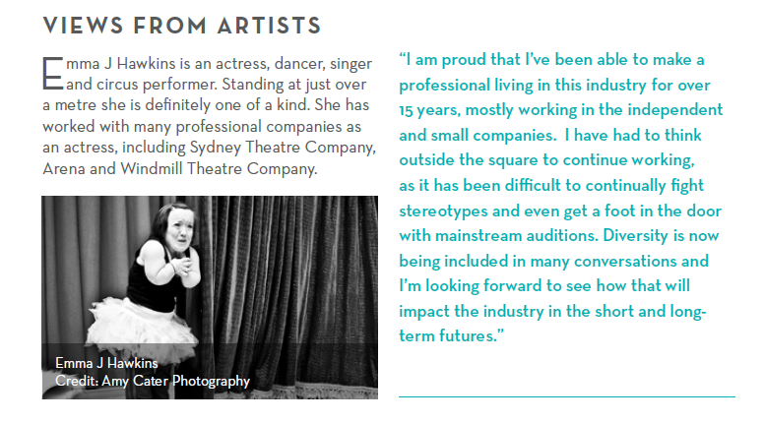
It comes back to the art and the artists
Notes:
Finishing with an excerpt from our recent study on artists careers Making Art Work –which examined the size of the current artist population
The Australia Council response featured examples from a range of artists – including performer Emma J Hawkins who summed up the challenges and opportunities for artists that sums up the ingenuity and creative as well as the challenges for artists who disrupt dominant conceptions and representations and who are reframing Australia’s artistic canon as they forge their path …

