Slide 2
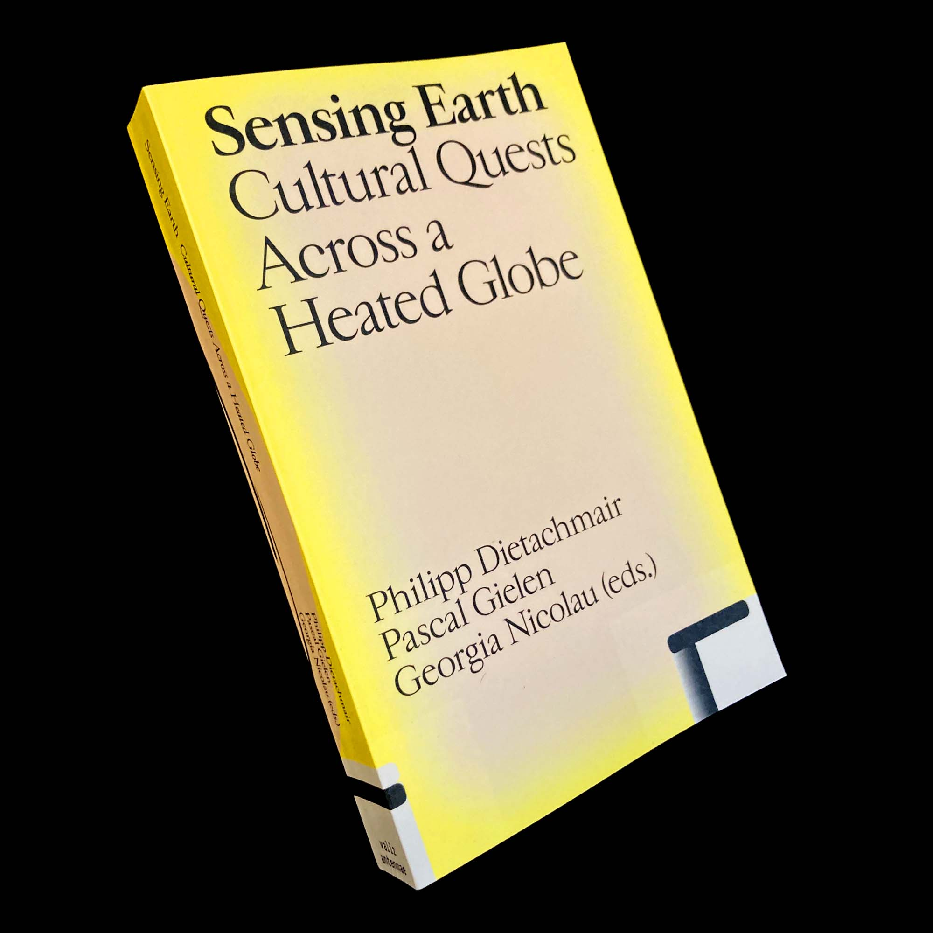

Slide 3
overheated cultures in undercooled flatscapes

Slide 4
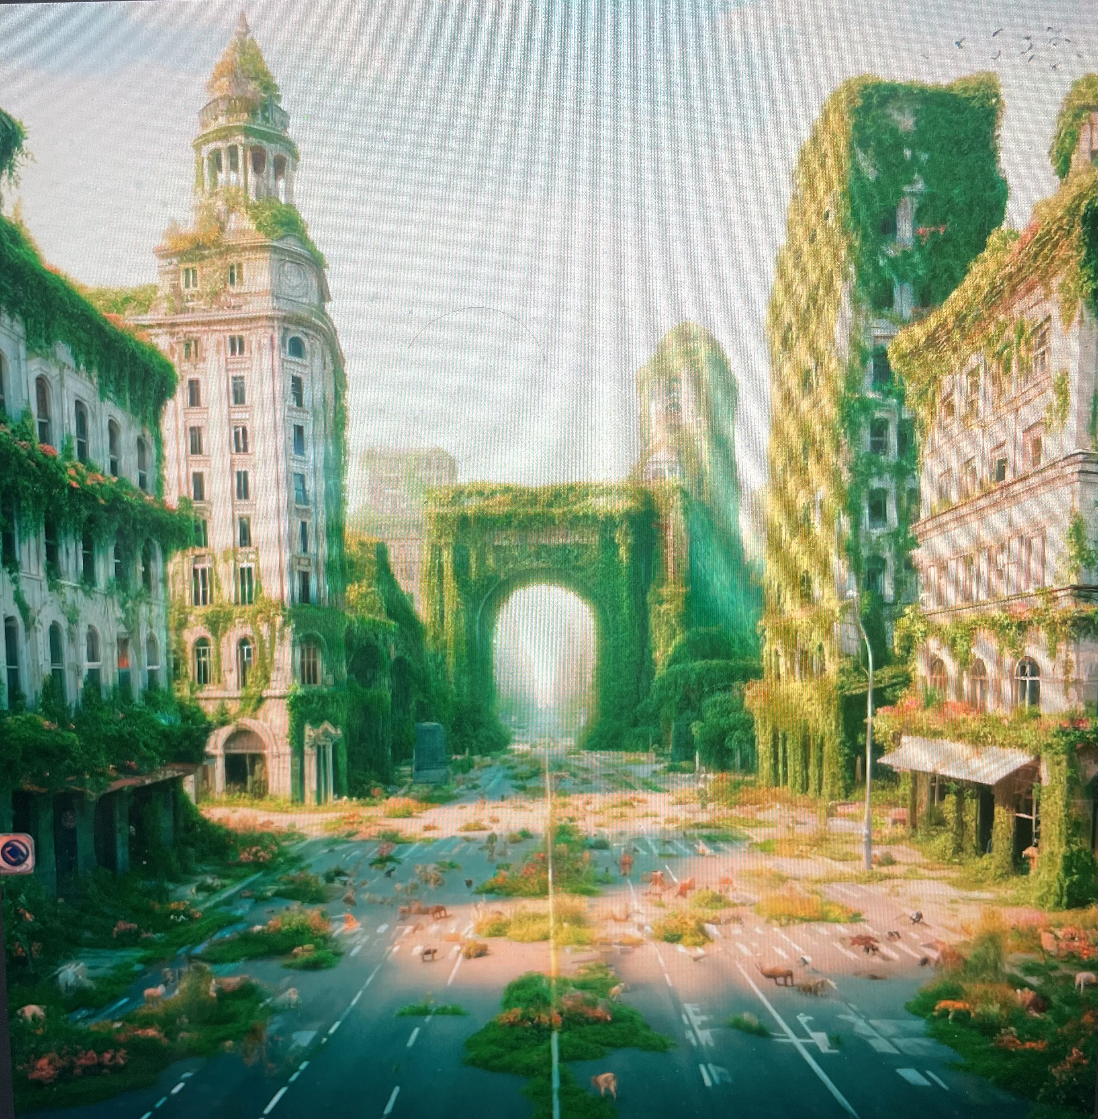
an earthly paradise…
without people

Slide 5
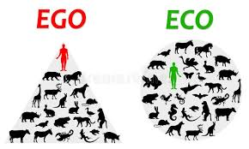
climate struggle = antropocentric
saving our own skin
environmental crisis = cultural crisis
science and technology alone cannot
save the world
eco-capitalism

Slide 6
changing our way of living, working and making love
empirical proof does not convince us to change our behaviour
climate report after climate report
cultural revolution

Slide 7
the nearness conundrum

Slide 8
sensory deprivation
+ affective deprivation
= aesthetic deprivation

Slide 9
beautiful thinking
representing the unrepresented
distant gaze
looking at the landscape
redistributing the senses
aesthetics

Slide 10
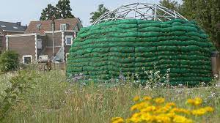
aesthesis
all the senses related to emotions
in the landscape: situational in-situ art (gaia)
sense of physical nearness
local slowness – rhythm of life
resonance & ‘res-ponsability’

Slide 11
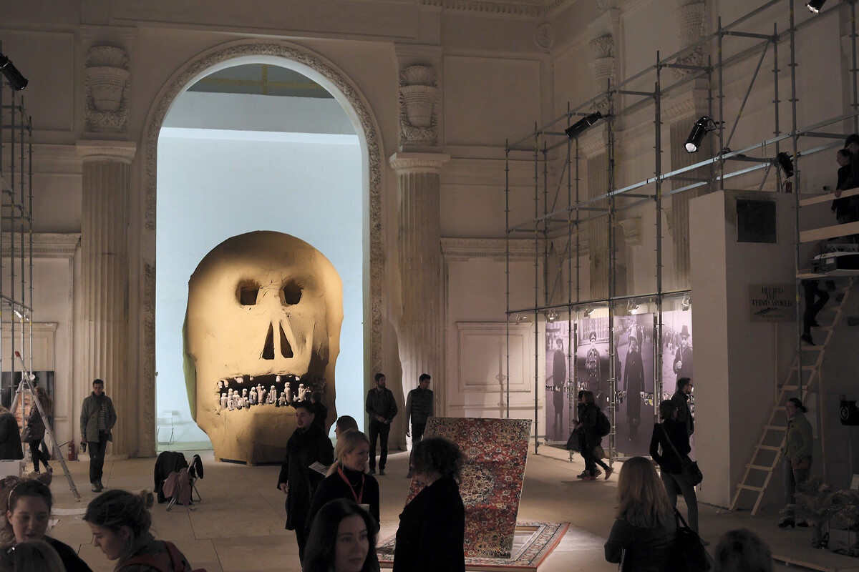
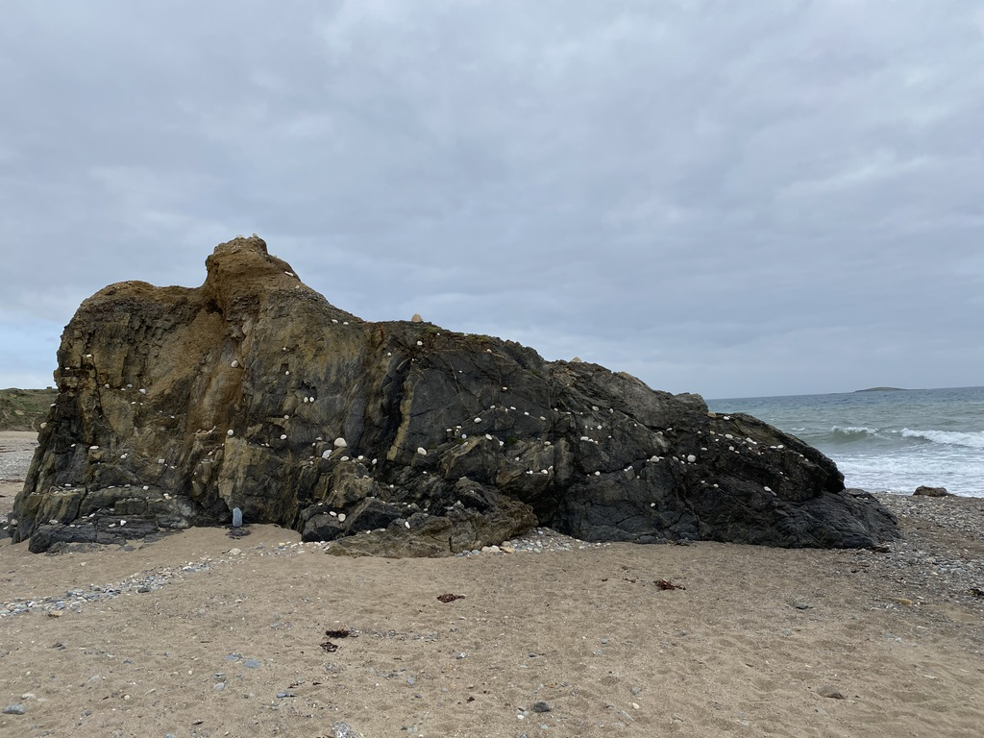
depth-aesthetics
under the landscape (chtôn)
sense of vulnerability
universal vulnerability and mortality

Slide 12
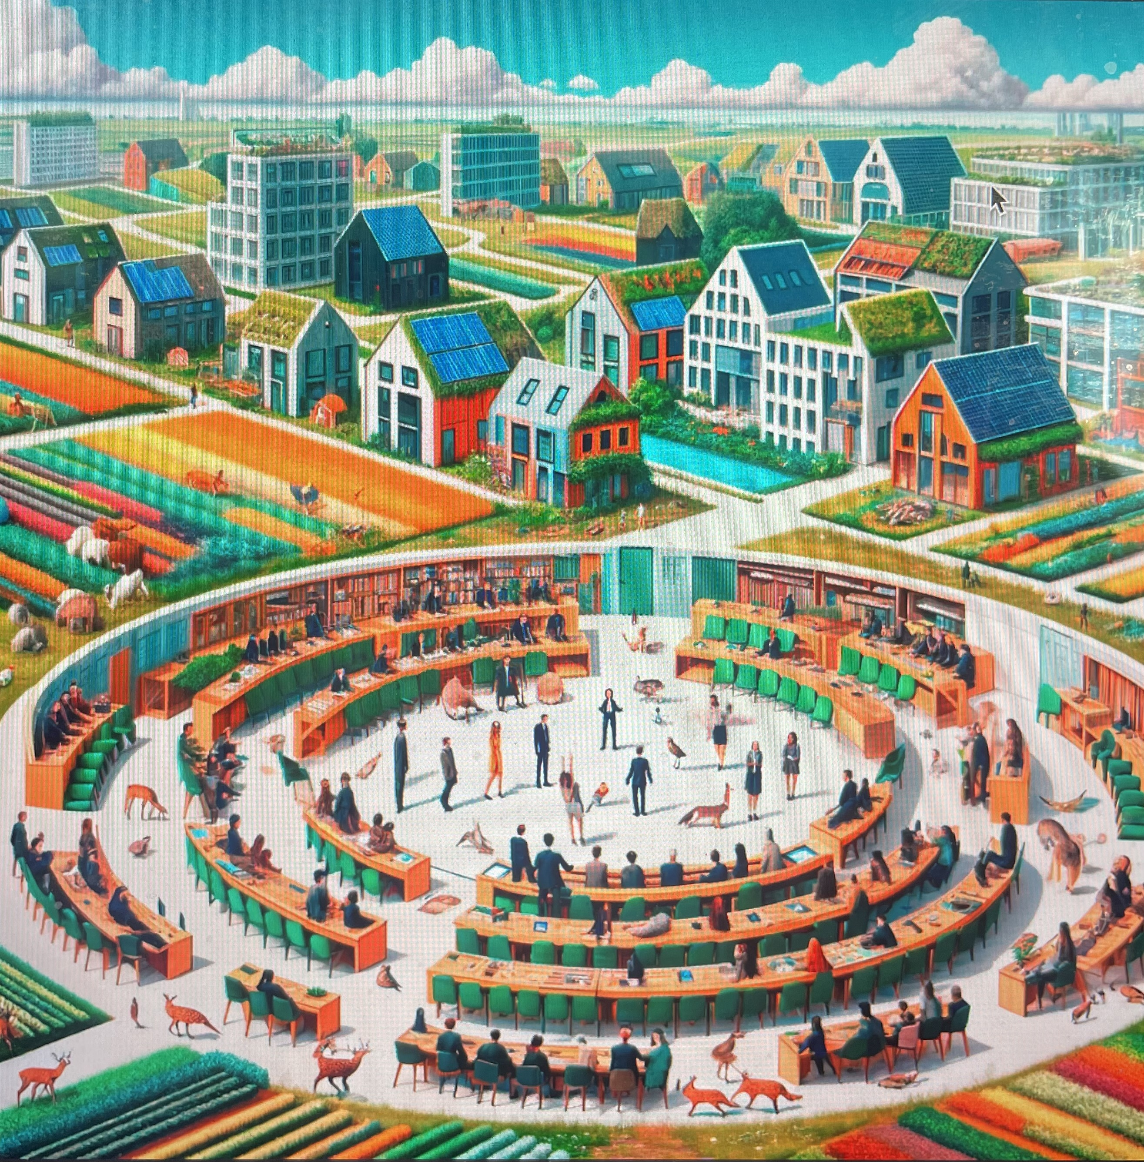
eco-political communities are built on
aesthetic foundations

Slide 13
Reset the Senses!
Slow Down!
Dance Away the Crisis!
Feel Again!

