Slide 1

Be SpectACTive!
2° edition [2018-2022]

Slide 2


Be SpectACTive! is an EU large scale cooperation project– co-financed by the European Commission program Creative Europe– working on the performing arts sector, through artistic productions and participatory practices, engaging spectators in the creative process.
ACTIVE SPECTATORS
Active Spectators participate in programming, with groups of spectators selecting productions to be programmed at the partner theatres or festivals. Spectator groups also engage in dialogue with artists during creative residencies where co-productions are developed.

Slide 3
the partnership

Slide 4
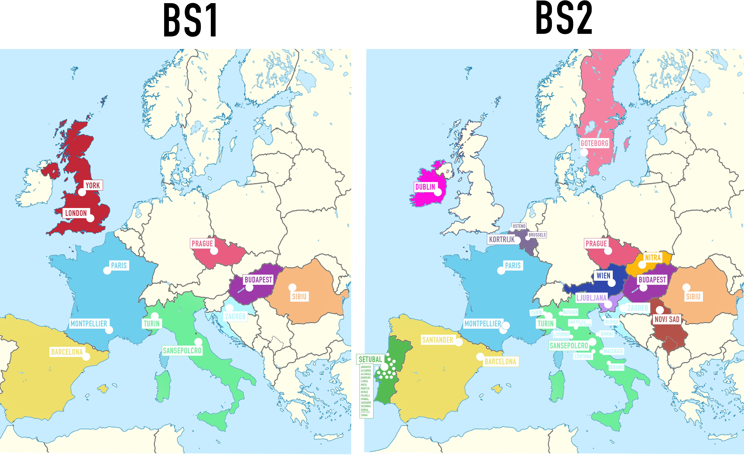

Slide 5
from 12 to 19 partners located in 15 cities
15 different European States (8 in the previous edition)
old partners
Associazione CapoTrave/Kilowatt (IT) Bakelit Multi Art Center (HU) Domino (HR)
Teatrul National Radu Stanca Sibiu (RO)
Tanec Praha (CZ)
and 4 research centers
Fondazione Fitzcarraldo (IT) Università di Barcellona (ES) Università di Montpellier (FR) CNRS (FR).
new partners
Dublin Theatre Festival (IE)
Gothenburg Dance and Theatre Festival (SE) International Theatre Festival Divadelná Nitra (SK) Arts Centre Buda in Kortrijk (BE)
Brut Wien (AT)
Institution Student Cultural Centre of Novi Sad (RS)
Plesni Teater in Ljubljana (SI)
CdAT – Café de las Artes Teatro in Santander (ES)
Artemrede (PT)
Réseau en scène Languedoc-Roussillon (FR).

Slide 6
from 1° to 2° edition

Slide 7

what we did
108 shows selected by spectators all around Europe
21 productions of new shows
54 creative residencies
5 International conferences
4 European Spectators Day editions
2 books
1 film

Slide 8

what we are doing
222 shows selected from spectators all around Europe
15 productions of new shows
60 creative residencies
8 European Community Artworks
4 International conferences
4 European Spectators Day editions
2 books
1 web influencer travelling in Europe

Slide 9
co-programming co-commissioning co-managing

Slide 10


training for new cultural professionals
Community Managers
creators of communities, local mediators with the aim of improving audience engagement practices in every venue or festival of the network
“capacity building” strategies, to increase internal competencies for realising a Peer Learning Network
Community Building

Slide 11

co-programming
in each venue, a group of active spectators select a number of shows to be programmed in the theatres/festivals/venues that are part of the network
co-commissioning
in 8 cities, we are developing European Art Commissioners‘ projects, where two local communities are linked with the common aim of commissioning an artwork for their two cities
co-managing
during development periods of the co-productions at creative residences, local communities meet with artists in a mutual process of exchange of experiences and ideas.

Slide 12
productions

Slide 13
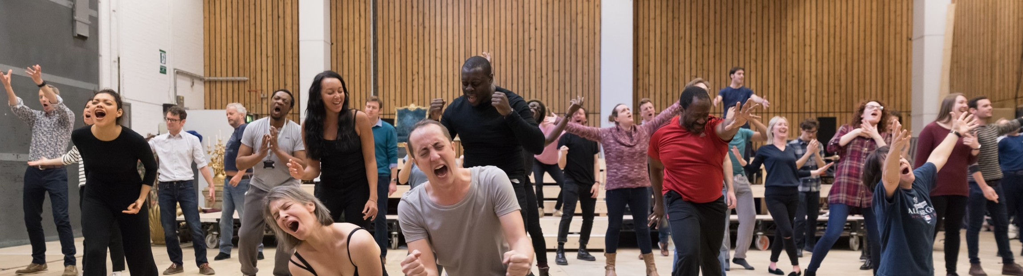
research bonus
each artist/company has a fee for studying and researching the topic of their show to be produced in the framework of Be SpectACTive!
creative residencies
each artist/company has 3 international residencies in 3 different cities of the network
residency in house
after the 3 residencies around Europe, the artist/company will have a final residence in their own country
bonus tournée
after the debut performance, each partner of the network will have at their disposal a bonus for buying any of the co-produced shows

Slide 14
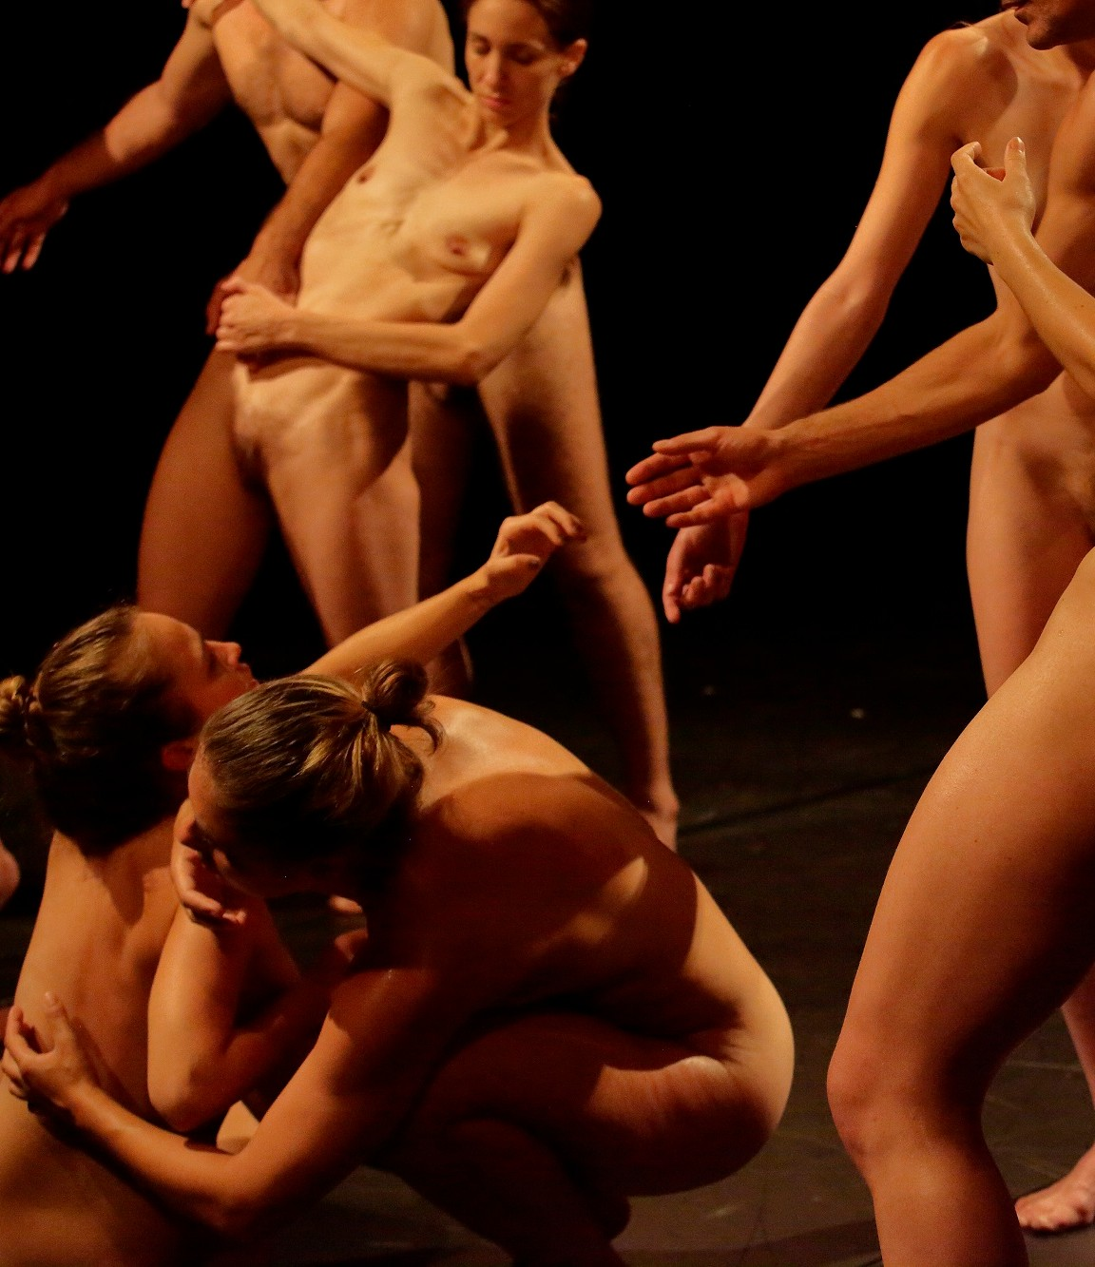
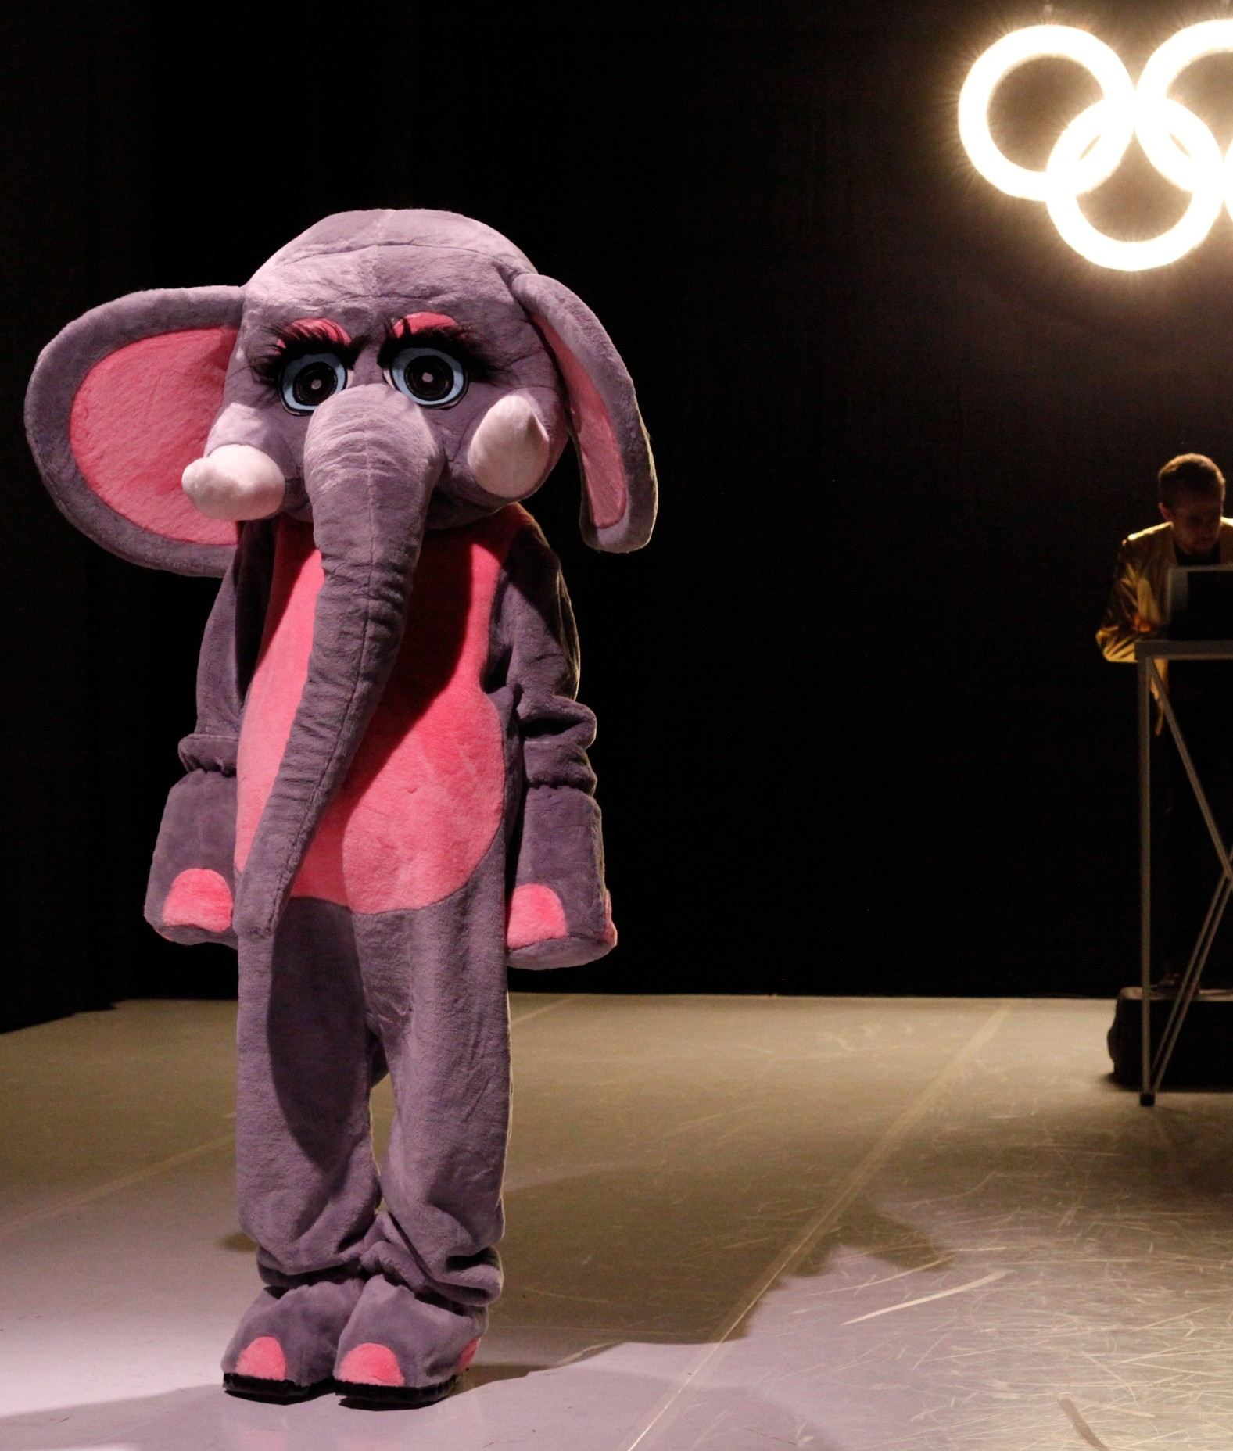
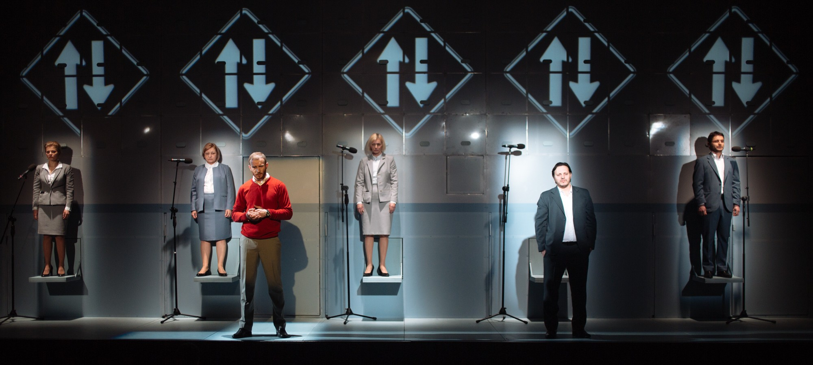
small scale
productions with 1-3 artists / 7,000 euros
medium scale
productions with 3-6 artists / 14,000 euros
large scale
productions with 6-10 artists / 21,000 euros
+ research bonus 1,500 euros + covering of all the travels/meals/accomodations expenses
45% of the full budget is devoted to the artists

Slide 15
international conferences,
research and scientific publications

Slide 16
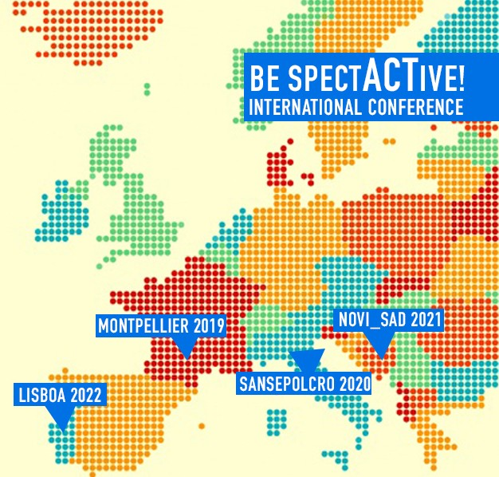
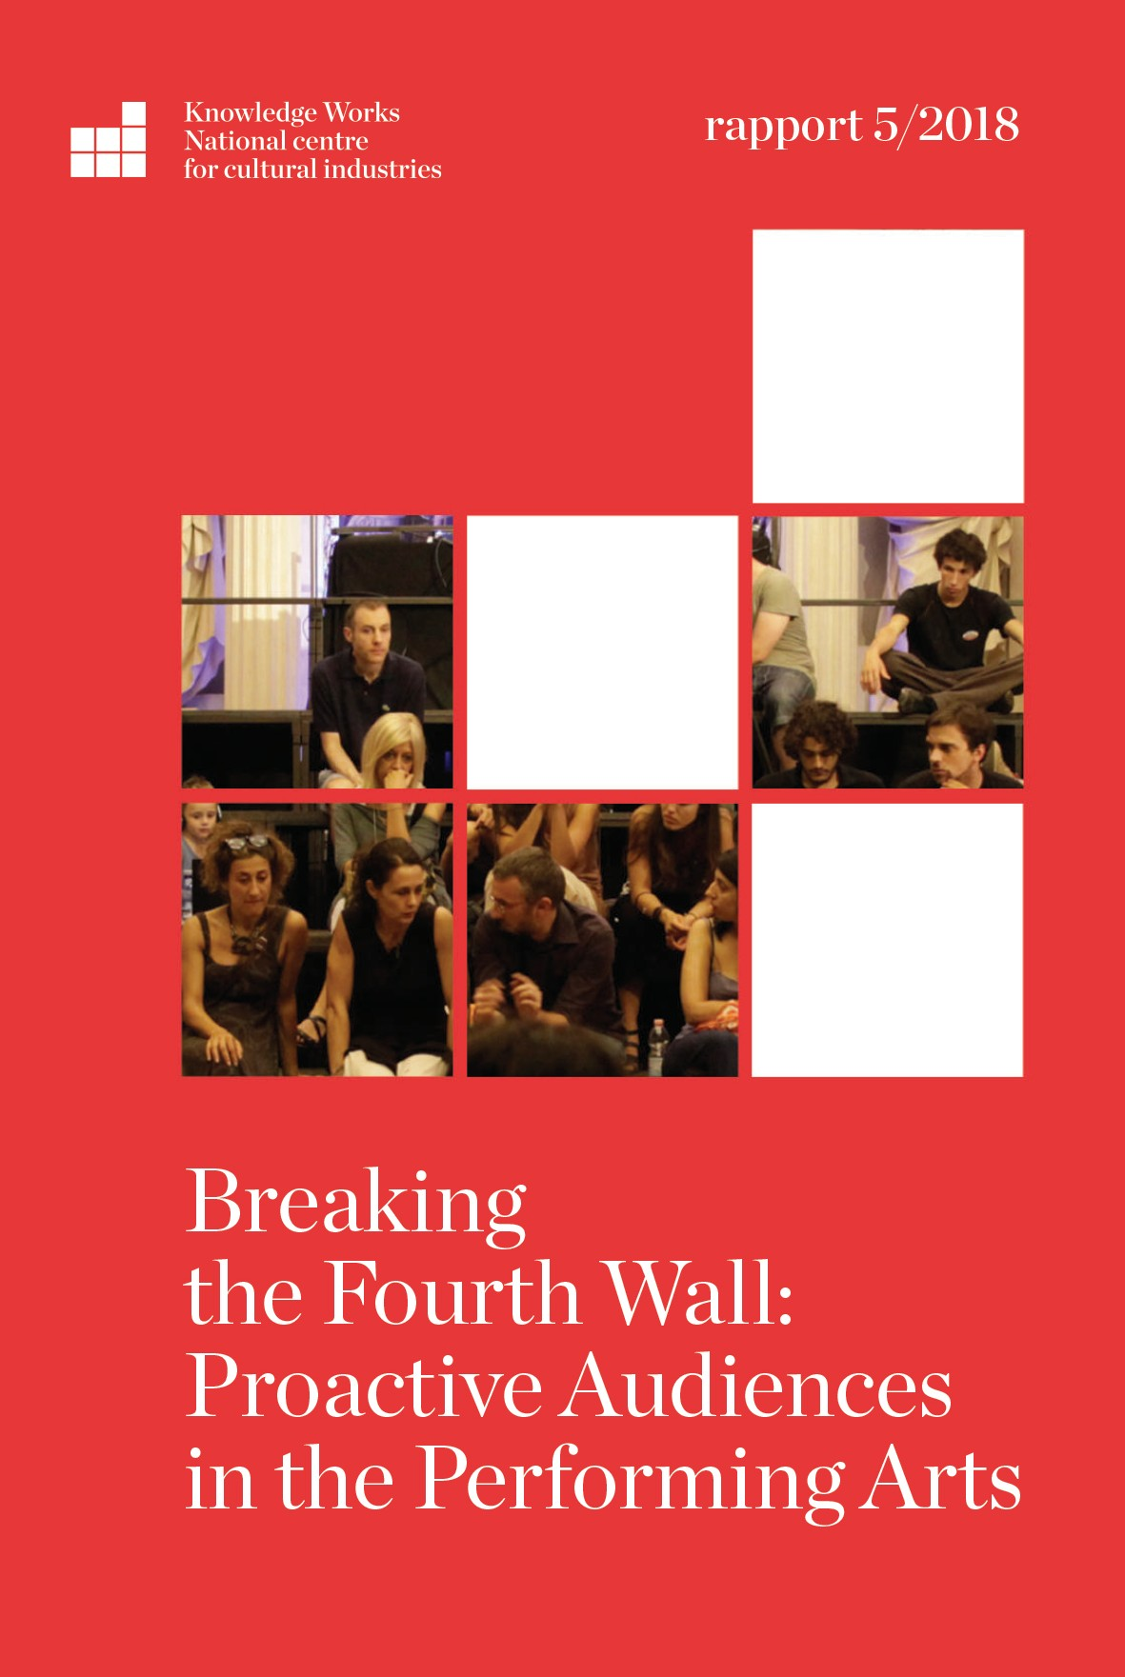
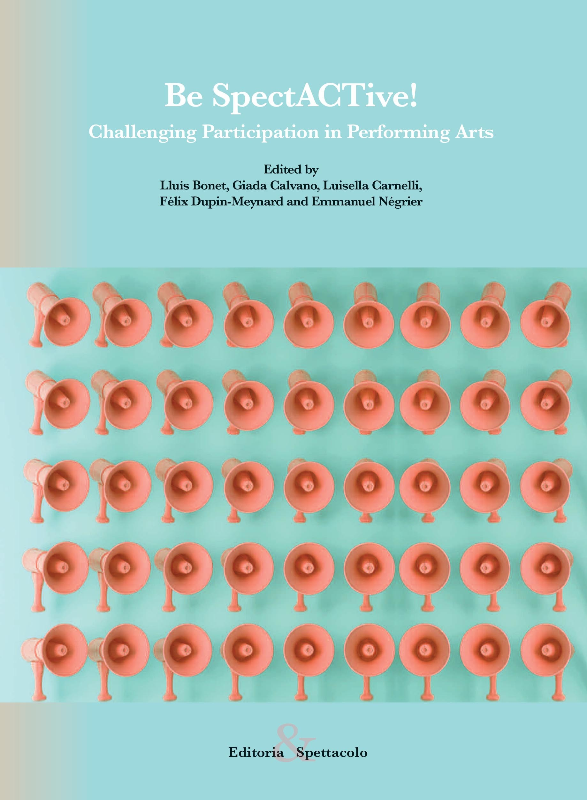
Be SpectACTive! international conference / 2° edizione

Slide 17
ESD / European Spectators Day

Slide 18
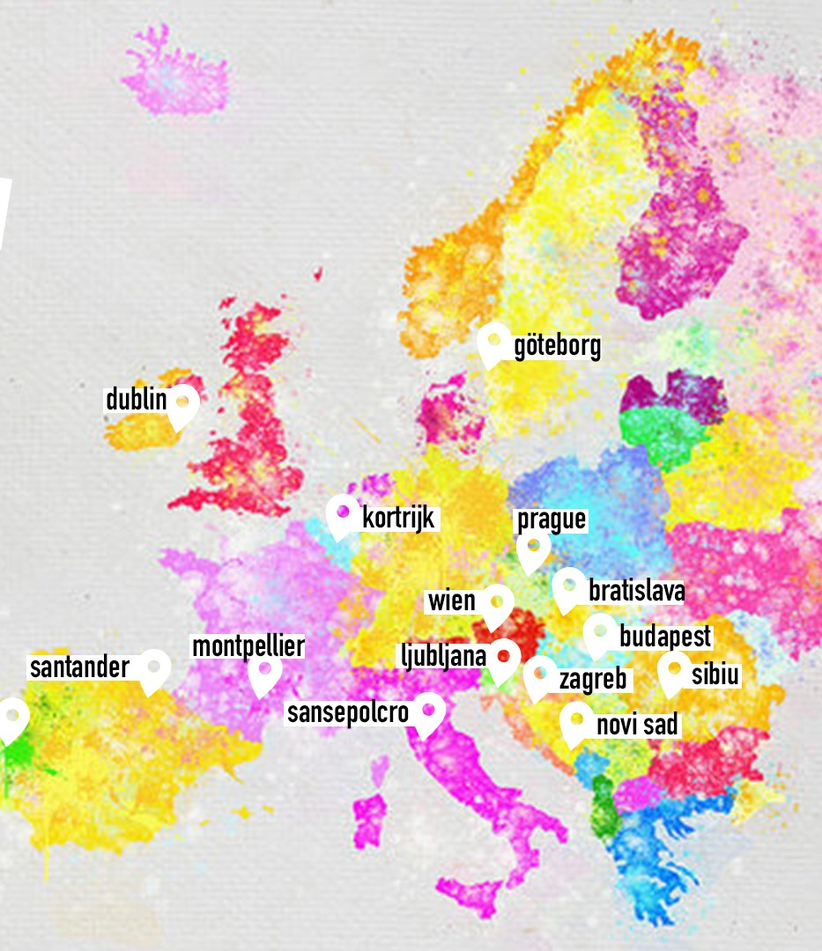

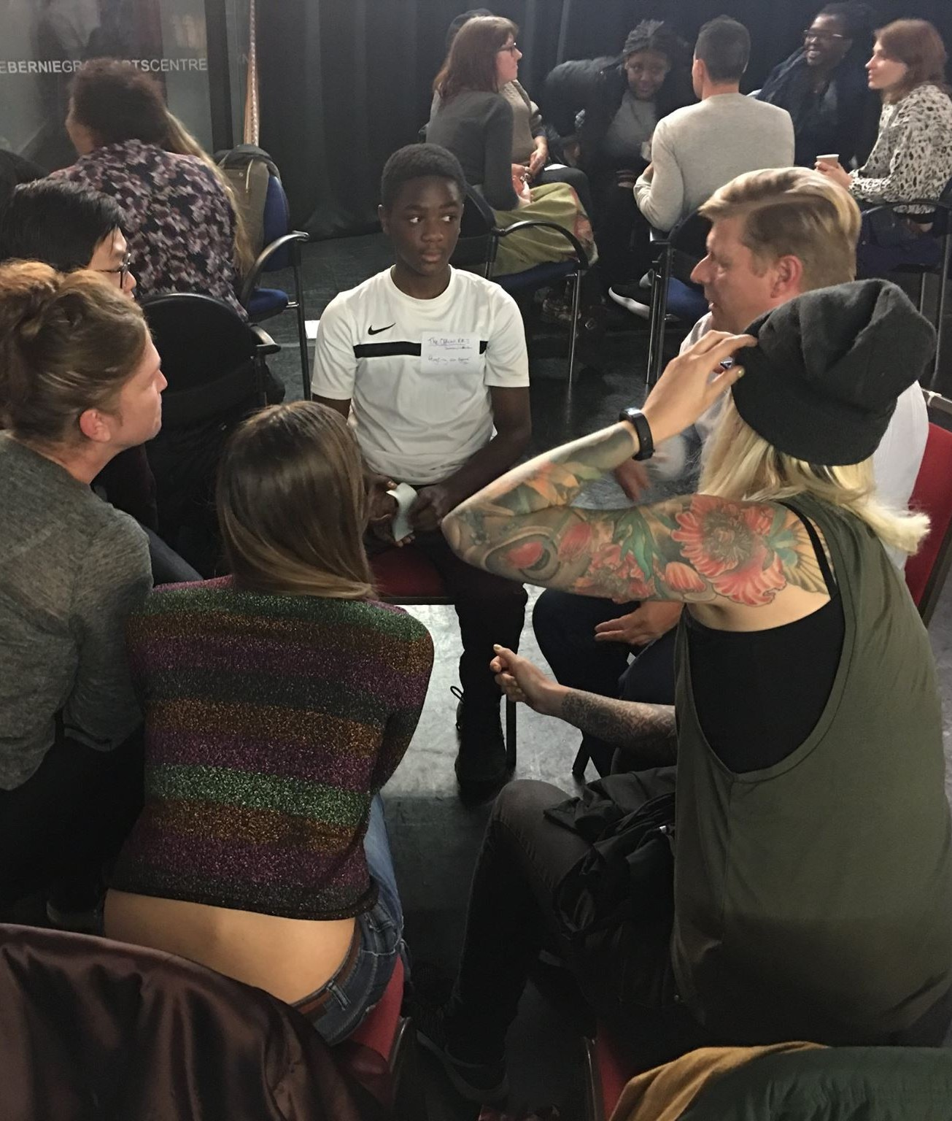
off-line and on-line event: European spectators interacting with each other about their experiences as active spectators

Slide 19
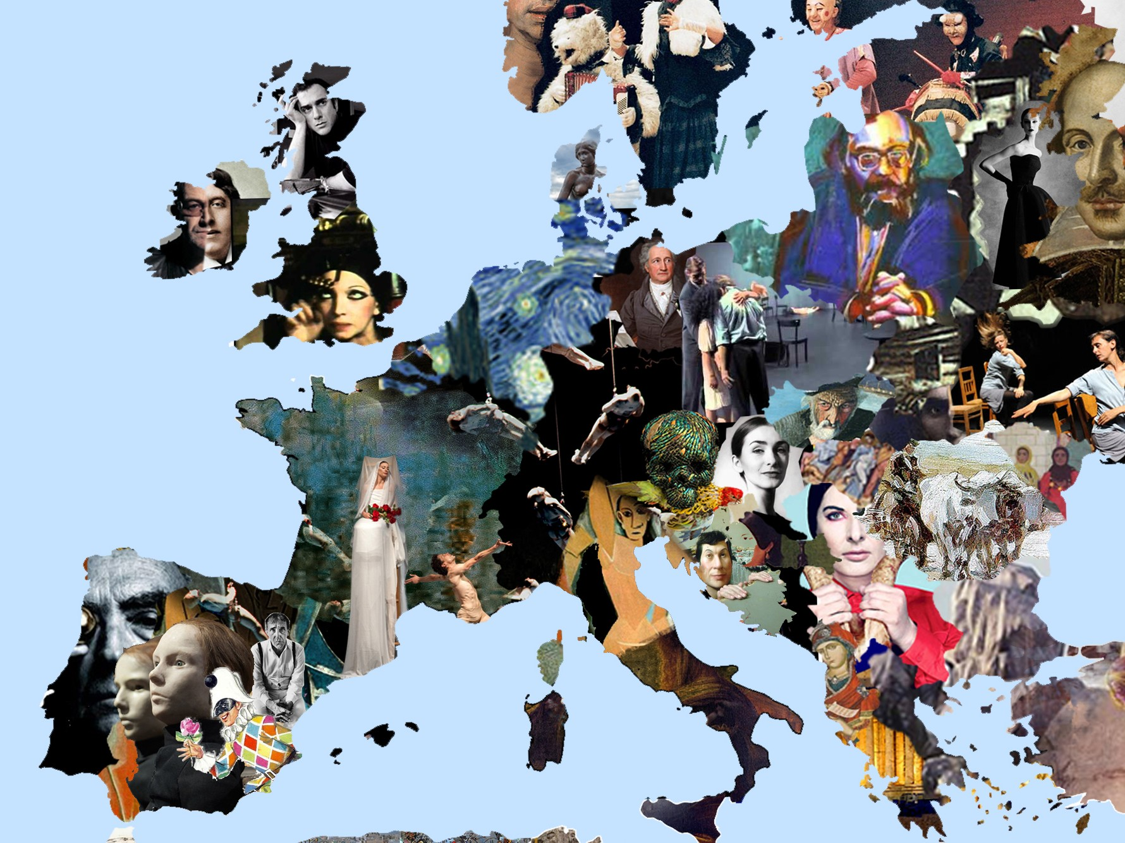

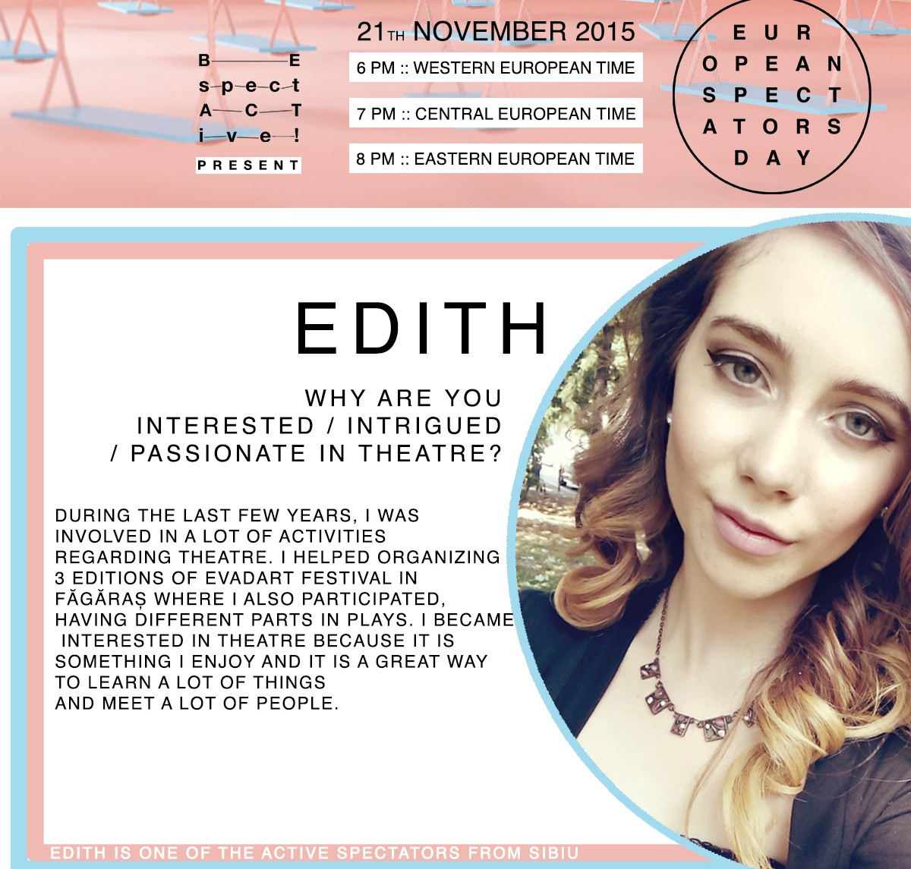
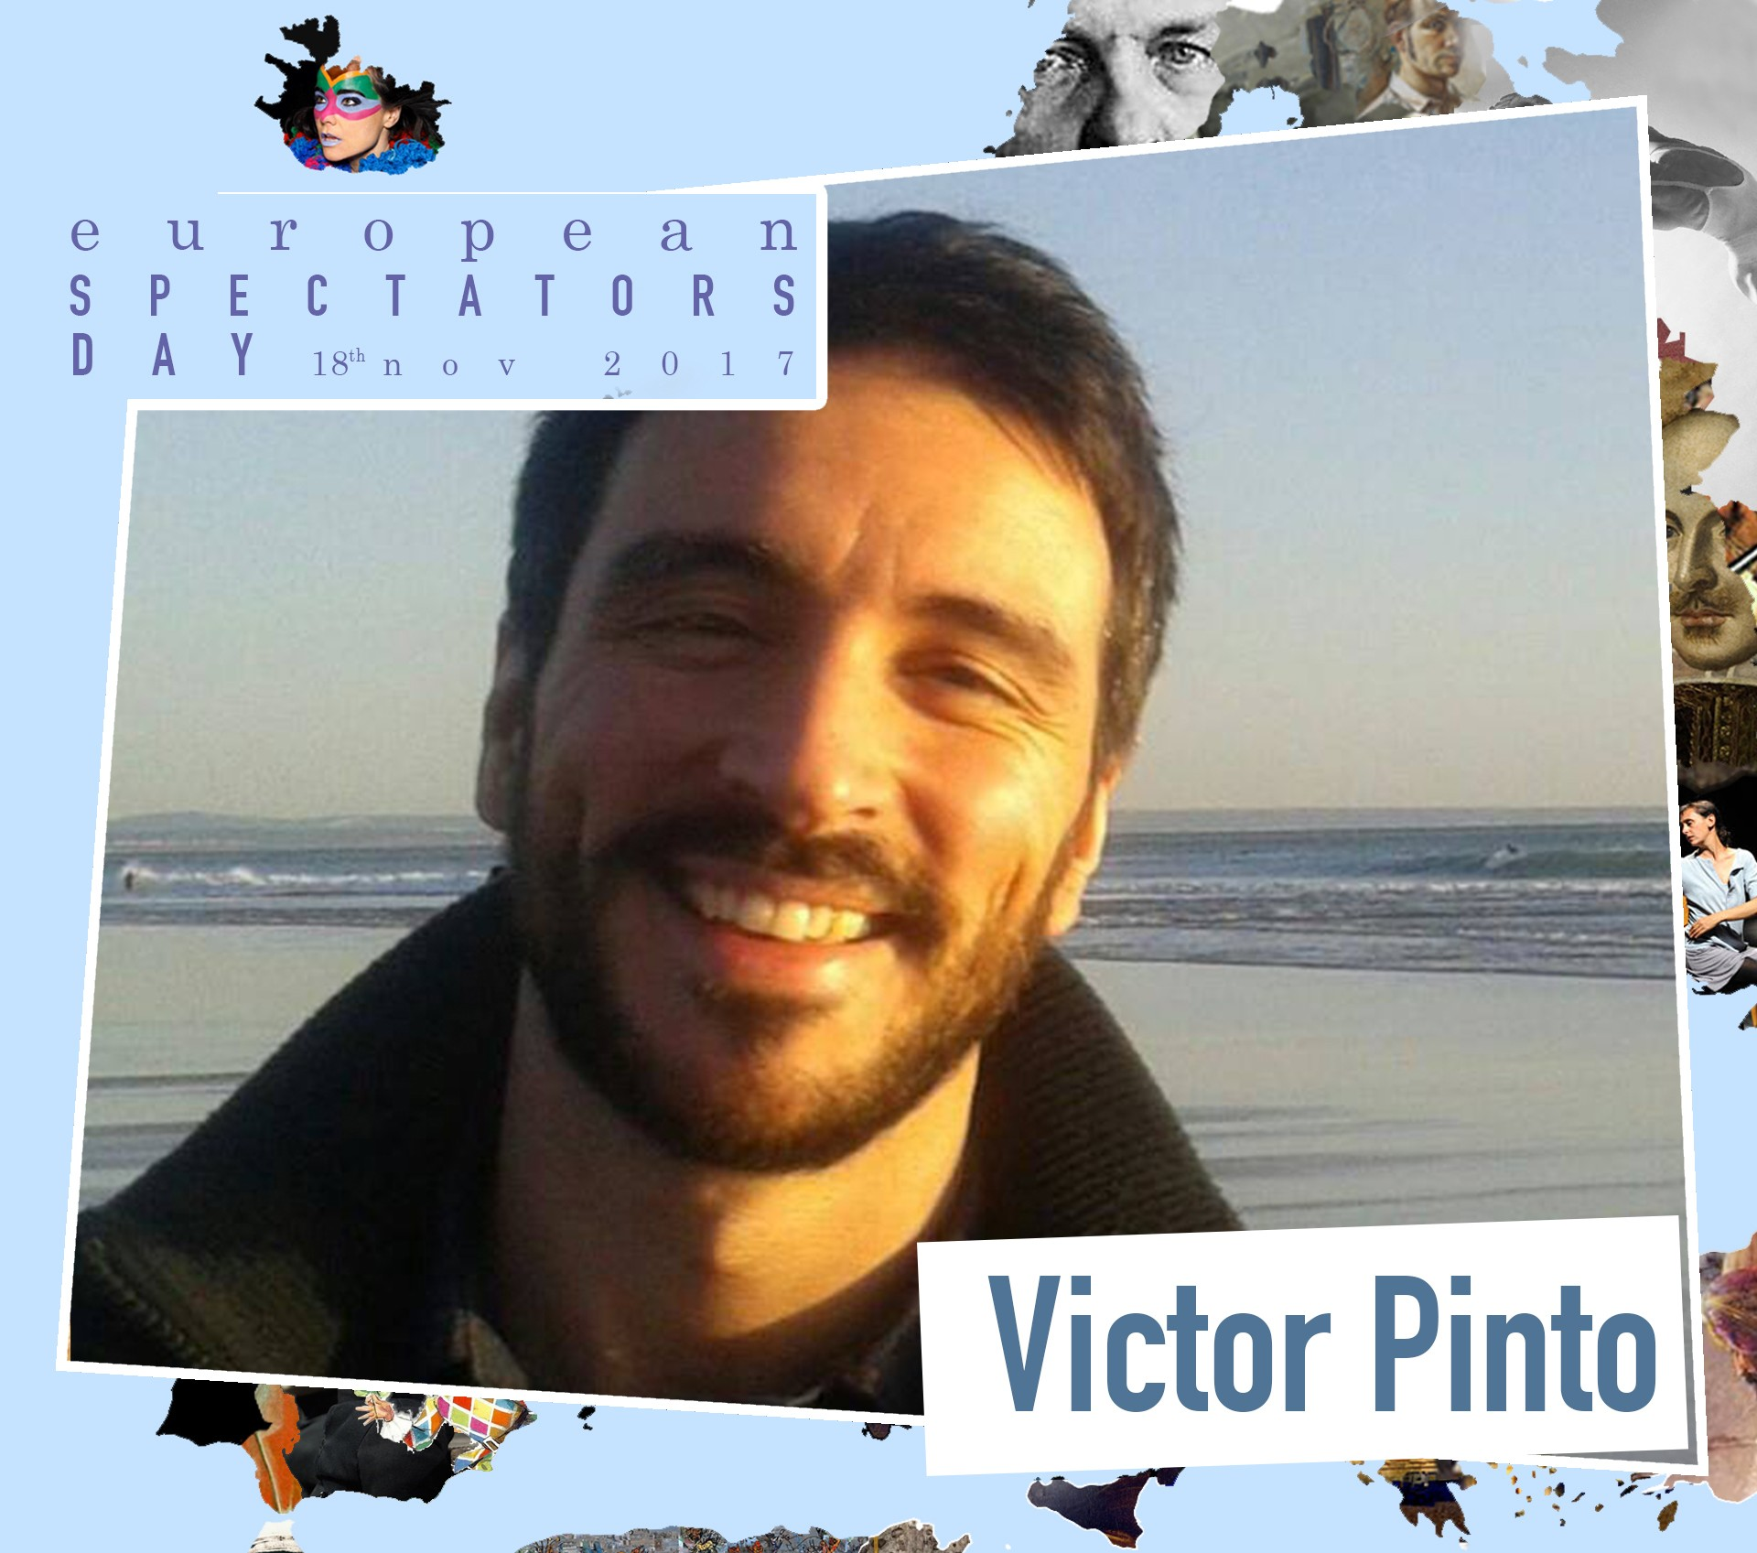
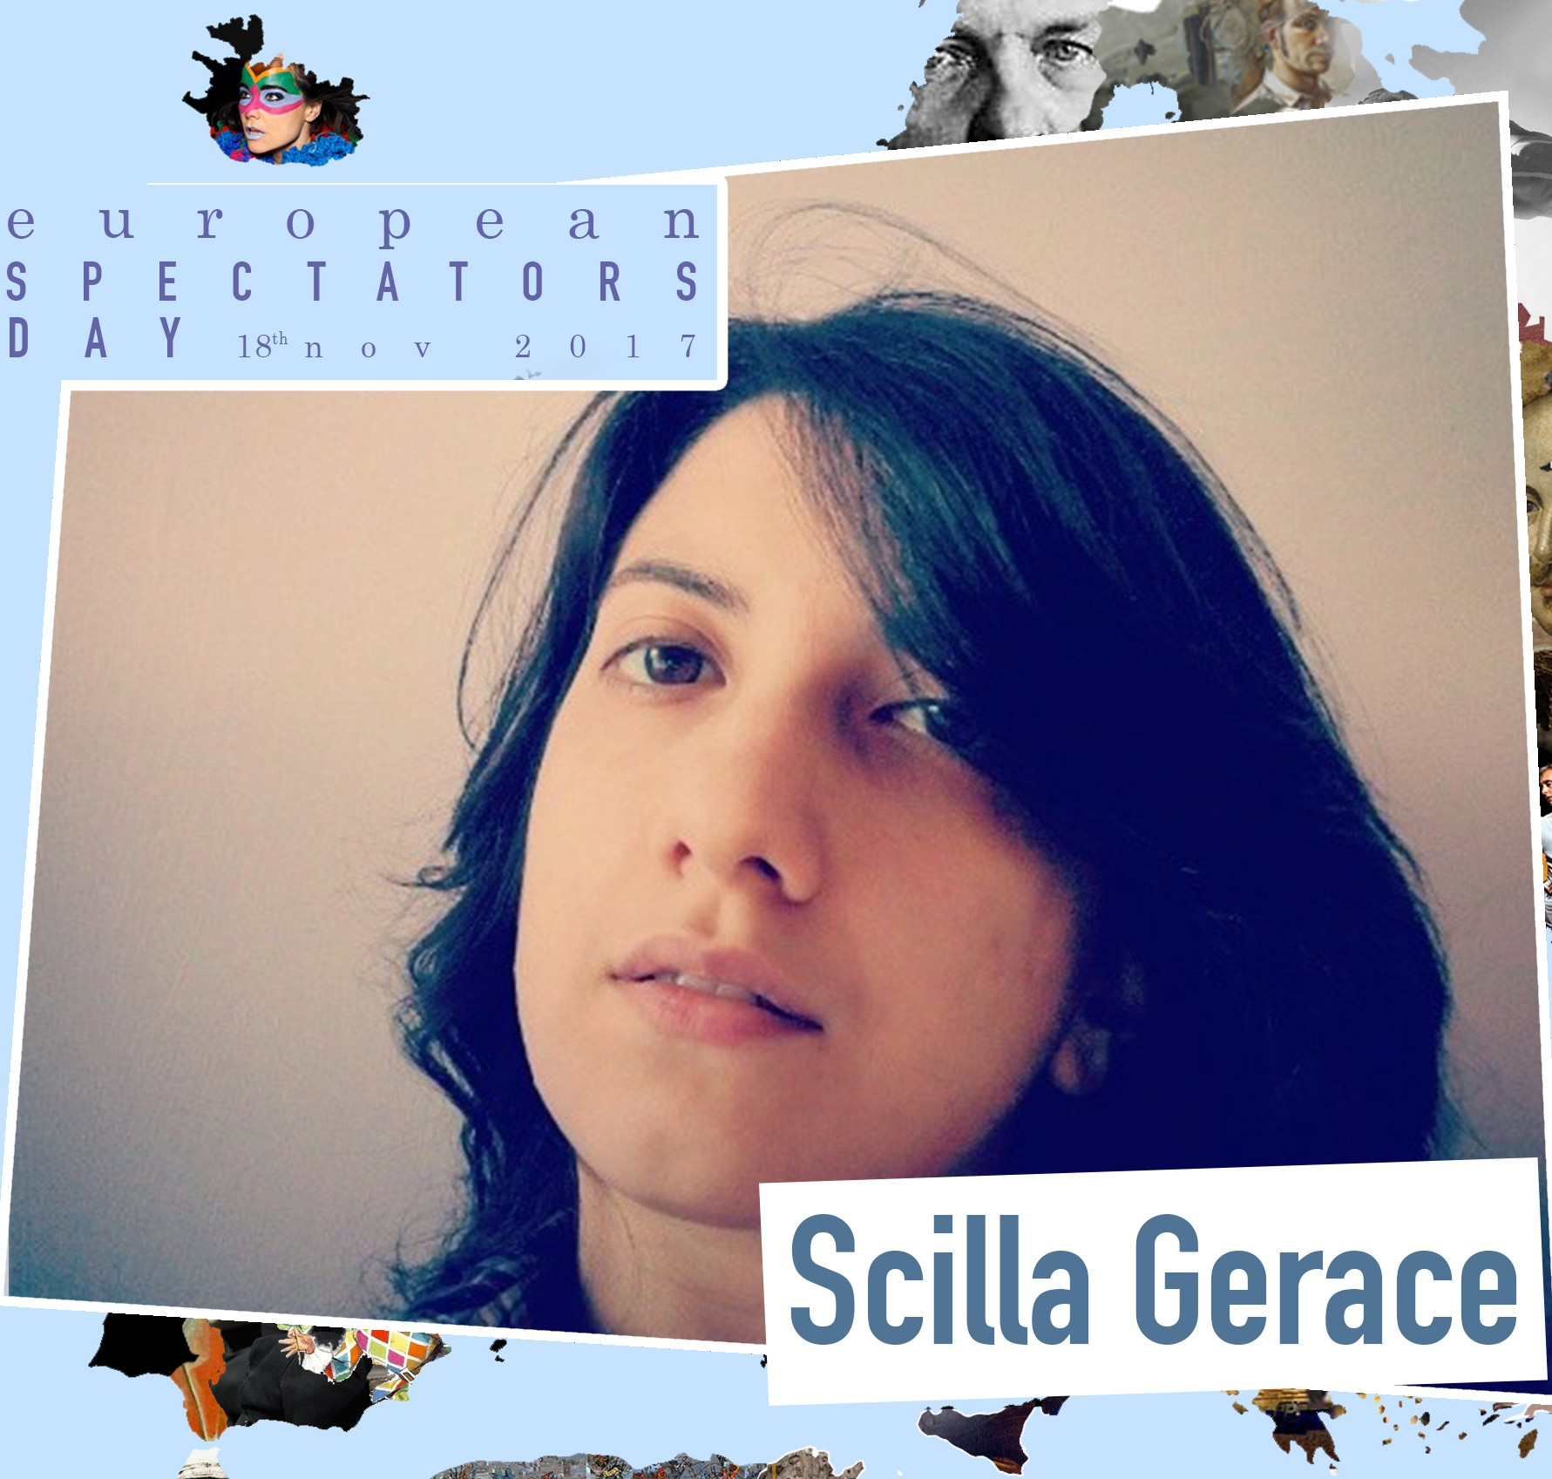

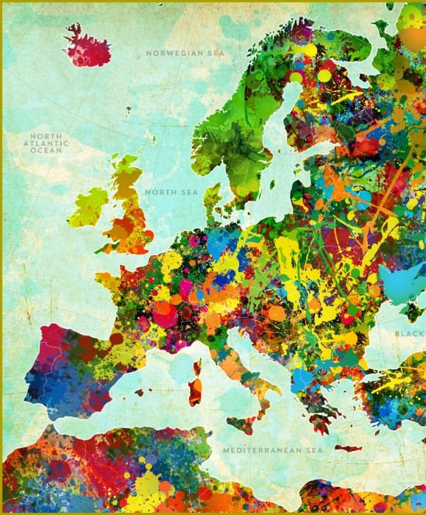
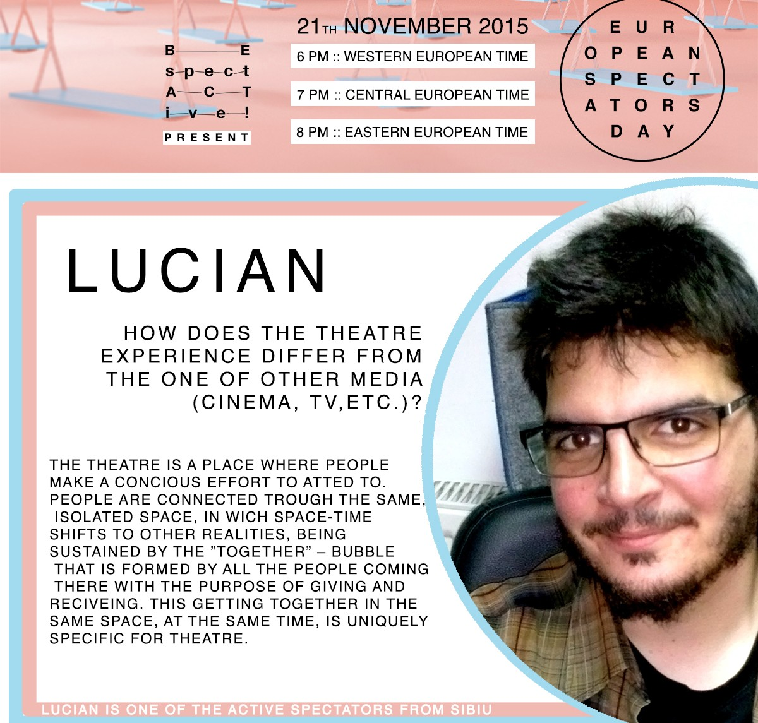

Slide 20
Follow us
facebook
Be SpectACTive! / European Spectators Day
instagram e twitter
@bespectactive
www.bespectactive.eu

